Slide 1
interfaithimmigration.org
Welcome to the IIC Webinar:
Faith Communities Mobilizing for
World Refugee Day
Call and Webinar will begin at 4:00 p.m. EST
To join the webinar, go to http://join.me/faith4immigration and follow the directions for audio and visual.
For audio only call: +1.202.602.1295 Access Code: 354-977-836#

Slide 2
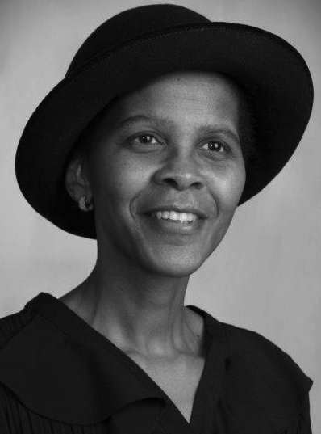
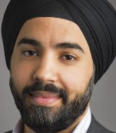
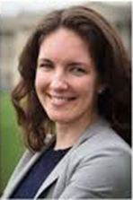

SPEAKERS/AGENDA
Ms. Clara Hart is Board Chair of Refugee Congress and co-founder of Refugee Women’s Association of Sioux Falls
Arjun Singh Sethi, civil and political rights writer, human rights lawyer, and Adjunct Professor of Law at Georgetown Univ. Law Center and Vanderbilt Univ. Law School.
Jen Smyers
Director of Policy & Advocacy Immigration and Refugee Program
Church World Service
Dr. Sharon Stanley-Rea,
Director, Disciples Refugee & Immigration Ministries

Slide 3
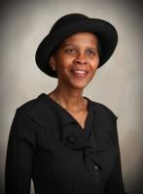
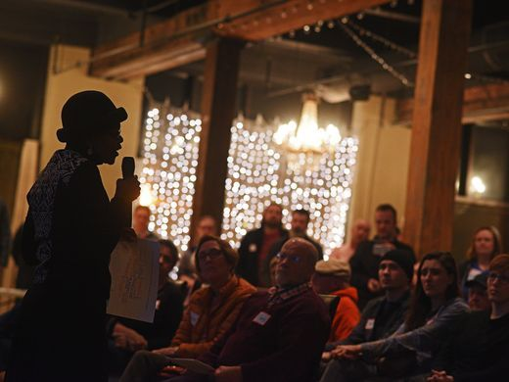
CLARA HART

Slide 4
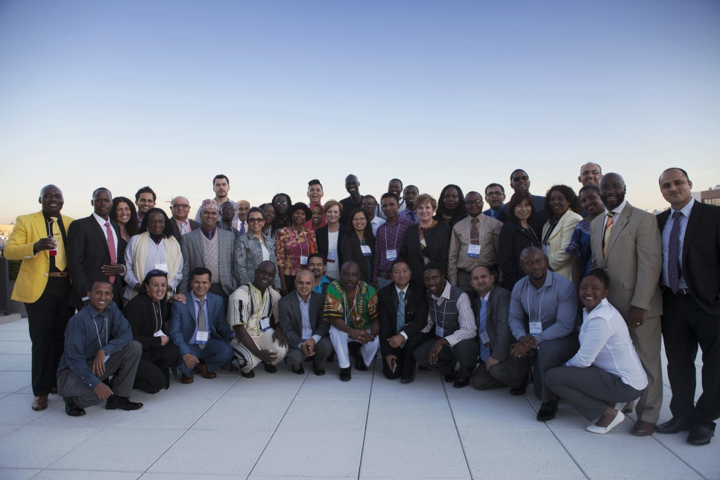
Refugee Congress

Slide 5
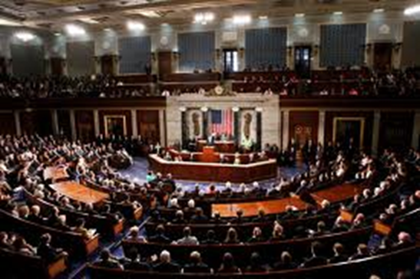
LEGISLATIVE UPDATES:
FY17 Supplemental Funding for Department of Homeland Security
Provides an additional $1.5 billion for immigration enforcement, which is half of what the White House requested.
No funding for a "border wall" per se, but provides funding for replacing parts of the existing fence and other border infrastructure.
No funding for hiring more ICE/CBP agents, but provides funding for recruitment and incentives for hiring in the future.
There is an expansion of detention funding, but
most of the funds are to pay for detention that
occurred in the last six months of the Obama
Administration.
The real test will be to see if this creates a precedent
for FY18 funding, so our voices must be heard:
NO FUNDING FOR TRUMP’S DEPORTATION MACHINE:
WALLS, FENCING, DETENTION BORDER & ICE AGENTS

Slide 6
Refugee & Muslim Ban
March 6th Executive Orders
90-Day ban on people from Iran, Libya, Somali, Sudan, Syria, Yemen
120 day suspension of the entire refugee program
Lowers goal for refugee admissions from 110,000 to 50,000
Hawaii Attorney General litigation = TRO & injunction
HIAS, IRAP, MENA lawsuit in in Maryland = TRO & injunction
The administration appealed both injunctions
Fourth Circuit (IRAP and HIAS) to be heard May 8 before en banc panel
Ninth Circuit (Hawaii) to be heard May 15
Both hearings to be live streamed on C-SPAN
Will likely be decided by the Supreme Court

Slide 7
Current State of Refugee Resettlement
Fiscal Year 2017 (Oct 1 2016 – Sep 30 2017): May see 65,000 – 70,000 arrivals
More than 50,000 DHS-approved refugees won’t be able to arrive this year
Security checks are expiring, can’t request repeats
DHS interviews not being conducted or scheduled
Fiscal Year 2018 (Oct 1 2017 – Sept 30 2018): Likely admissions goal of 50,000, possibly much lower arrivals
Historic average admissions goal: 95,000
Historical average actual admissions: 85,000

Slide 8
Tell Your State Governor or Attorney General to Withdraw Endorsement of Refugee Ban
13 states have filed a joint amicus brief in support of the Refugee and Muslim ban executive order. We are inviting state and local organizations and faith leaders to join a sign a letter urging these states to withdraw their endorsement.
Alabama – https://goo.gl/forms/lNO7FbpF626vyWS82
Arizona – https://goo.gl/forms/PQxdl9RlKdoYwCGt1
Arkansas – https://goo.gl/forms/pyD8xBoiYkMPHh5j1
Florida – https://goo.gl/forms/WCo4HVd4gB4fuM9h2
Kansas – https://goo.gl/forms/AdXx73f8sBp8qeQX2
Louisiana – https://goo.gl/forms/MjG8M3RZ2S3wue1o2
Mississippi – https://goo.gl/forms/aD6myk5NM0xv8Lw63
Montana – https://goo.gl/forms/6xIYIlOvfxuNJYlI3
North Dakota – https://goo.gl/forms/jd7o9rGAcUpkuVi52
Oklahoma – https://goo.gl/forms/8vR0RrKz740R2mvw2
South Carolina – https://goo.gl/forms/A6TE3OMhqbRoZrhP2
South Dakota – https://goo.gl/forms/v4R4TLrH9MwGEScJ3
Tennessee – https://goo.gl/forms/YdAQARTCTAhsRKXG3
Texas – https://goo.gl/forms/Dzakwx7Y85Euq4Cn2
West Virginia – https://goo.gl/forms/9UFbLNyap2GVIrfV2

Slide 9
Policy Update:
2017 Omnibus
Refugee & Entrant Assistance / ORR: $1.674 billion (same as FY16)
Migration & Refugee Assistance / PRM: $3.06 billion (same as FY16)
Emergency Refugee & Migration Assistance / PRM: $50 million (same as FY16)
International Disaster Assistance / USAID: $3.8 billion ($1.02 billion more than FY16 to address famine conditions)
Additional 2,500 Afghan Special Immigrant Visas
Lautenberg Amendment extension is included
FY18 Funding Fight Starts Now!
Anti-refugee, anti-asylum & anti-immigrant legislation starting to be considered by House of Representatives

Slide 10
Anti-Refugee State Proposals
Overall: 35 anti-refugee proposals in 19 states
Texas:
  SB 260, abolishing the state Office of Immigrant and Refugee Affairs, passed the Senate and was sent to the House
  HB 582, pertaining to drivers licenses and IDs for refugees, asylees, and LPRs, passed House Committee and sent to Calendars
  SB 4, anti-sanctuary “show me your papers” bill
  www.interfaithimmigration.org/2017/05/08/200-texas-religious-leaders-condemn-anti-immigrant-legislation-sb4/
North Dakota: HB 1427, amended to direct consideration of a refugee resettlement study, enacted in April and is waiting to be “selected” for a study
South Dakota: SB 124, amended to require data collection from resettlement agencies to the Governor and Legislature on services, communities receiving and how many refugees, demographic information (age, sex, country of origin)
www.interfaithimmigration.org/state-by-state-legislation/
Notes:
If signed and implemented by Governor Burgum, this poorly written bill would result in a discriminatory study of refugees that could burden Lutheran Social Services (LSS) of North Dakota – the state’s only refugee resettlement agency – and further demonize refugees whose only crime is seeking out safety and welcome in a new home.
The bill makes dangerous assumptions about refugees and would further the misconceptions that already exist in the public discourse. Refugee status is a legal immigration status that is time limited and, as with all legal residents and citizens, refugees have the right to move freely across communities and across state lines. This study would create an unwelcoming climate in North Dakota, not only for refugees, but all immigrants and newcomers to the state. Furthermore, this bill would invade the privacy of refugees who are eager to contribute to their communities, as well as burden LSS of North Dakota and the state government with an impossible, and unfunded, task. Finally, the study boils down refugee resettlement to a cost assessment with no attention paid to the countless economic, social, and cultural benefits that refugees bring to our state and country.
Call or write to Governor Burgum today and urge him to VETO HB 1427.
CALL (701) 328-2200
Here’s what you can say:
“I’m (name) from (city, county) and I’m [writing or calling] to urge Governor Burgum to veto HB 1427, that would result in a discriminatory study of refugees. This bill is an affront to North Dakota’s values of welcome, hospitality, and compassion and does not reflect the spirt of welcome that my community, my congregation, and our state stands for. HB 1427 invades the privacy of refugees and former refugees who have been welcomed into our communities as legal residents, and only increases the misplaced fear and misconceptions that exist in today’s public discourse. As a (person of faith/refugee myself/resident of North Dakota), I expect our state government to represent North Dakota’s values of welcome and stand with vulnerable refugees.”

Slide 11
Pro-Refugee State Proposals
Overall: 29 pro-refugee proposals in 18 states
Common theme to denounce refugee ban executive orders, declare welcome for refugees and immigrants
Maine: LD 1412 establishes the Immigrant Workforce Development Fund to provide funding to ethnicity-based community organizations for programs and services to help immigrants and refugees achieve economic self-sufficiency
California:
  AB 343, pertaining to in-state tuition for refugees and SIV recipients, amended to pertain only to California Community Colleges (passed committee on higher ed, referred to appropriations)
  AB 349, preferencing state civil service positions for SIV recipients (passed committees, referred to appropriations)
  SB 54, the California Values Act, separates criminal justice & immigration systems, no state/local resources fuel mass deportations, ensures schools, hospitals, courthouses are safe spaces, passed Senate & sent to Assembly
  www.interfaithimmigration.org/state-by-state-legislation/

Slide 12
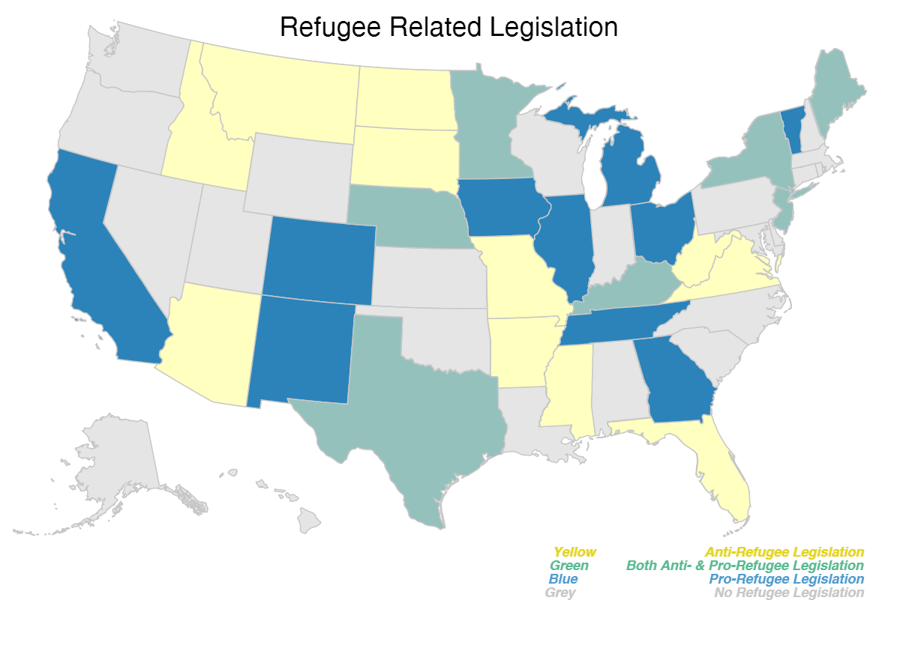
www.interfaithimmigration.org/state-by-state-legislation/

Slide 13
Call your State and Local Officials!
Find your governor, state legislators, mayor, and local official at www.usa.gov/elected-officials.
“I am a constituent from [CITY, STATE], and I urge you to declare welcome for refugees in our communities by supporting a welcome resolution and opposing any attempts to disrupt, curtail, or dismantle the refugee resettlement program. Resettlement is a core American legacy that extends hospitality and offers a chance for refugees to rebuild their lives in safety and dignity. My community welcomes refugees, and I urge you to reflect the best of our nation by supporting refugee resettlement in the United States.”

Slide 14

World Refugee Day Call-In Week: June 12th-16th
Generate 100,000 calls to Congress
We support welcoming refugees to the United States
We would like the United States to resettle more refugees next year.
Please let the President know of your support.

Slide 15
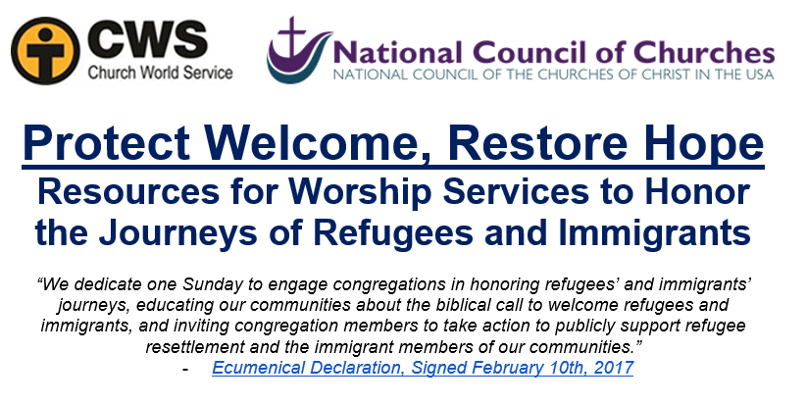
Dedicate a worship service to celebrating refugees’ journeys
greateras1.org/congregations

Slide 16
Take Action!
Meet with Member of Congress May 29- June 2 and with state and local policy makers any time!
RCUSA legislative visit toolkit: https://tinyurl.com/RCUSALocalToolkit2017
RCUSA World Refugee Day toolkit: http://www.rcusa.org/world-refugee-day/
USCCB World Refugee Day toolkit: USCCB toolkit: www.justiceforimmigrants.org
Sign on & say you support refugees!
  Health sector sign on: bit.ly/Health4Refugees
  Faith leader sign on: bit.ly/FaithLeaders4Refugees
  Educator sign on: bit.ly/Educators4Refugees
  Business leaders sign on: bit.ly/Business4Refugees

Slide 17
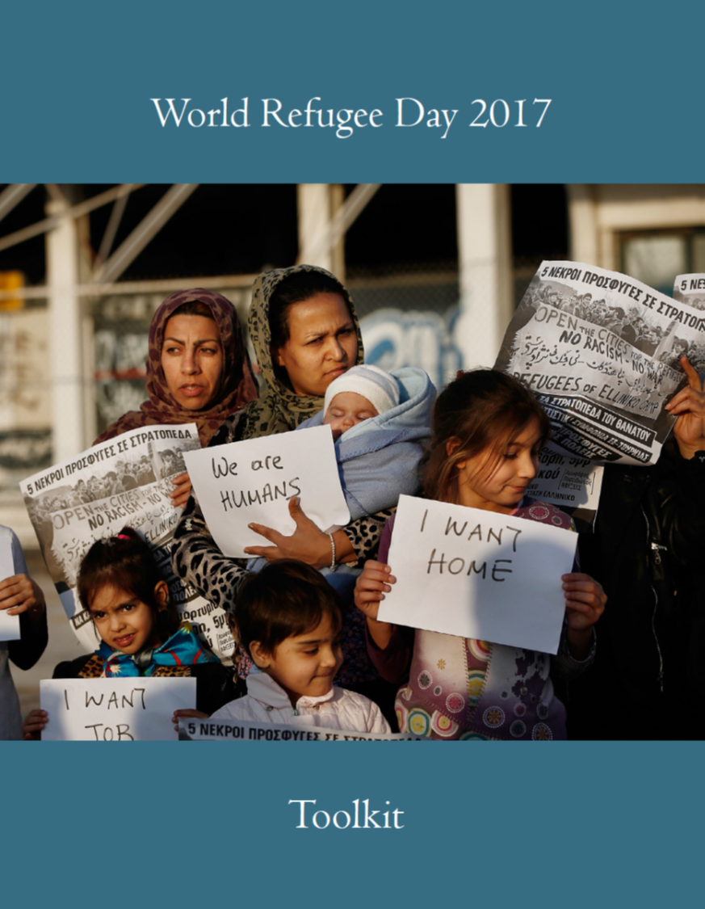
World Refugee Day
Toolkit
Talking Points
Engaging the Media
  Letters to the Editor
  Social Media
Prayer Resources
  Sample Intentions
Community Engagement
  Reach out to your member of Congress
  Become Active in your community

Slide 18
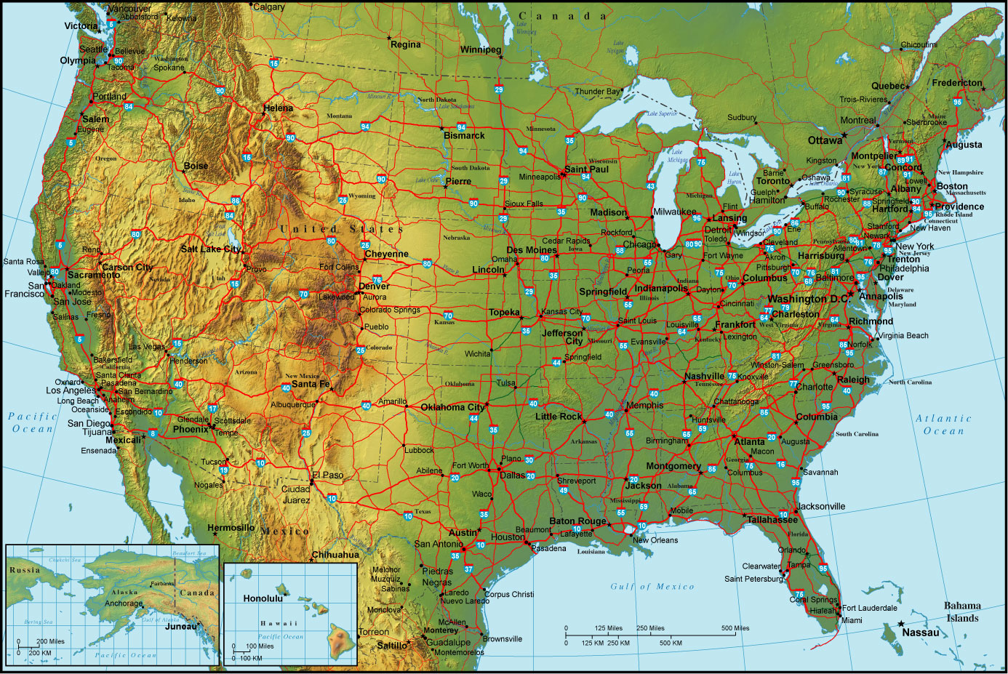
Tracking World Refugee Day Events

Slide 19


Slide 20
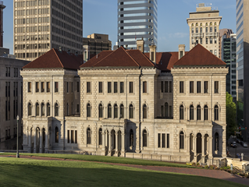
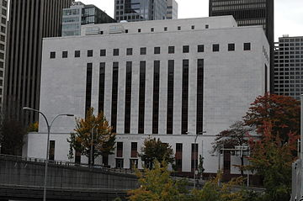

Resisting the Muslim Ban TODAY & Next Monday!
Joining the Rallies Against the Muslim Ban
MAY 8th: Richmond, VA. MAY 15th: Seattle, WA.

Slide 21

Resisting in Richmond,
VA. TODAY!

Slide 22
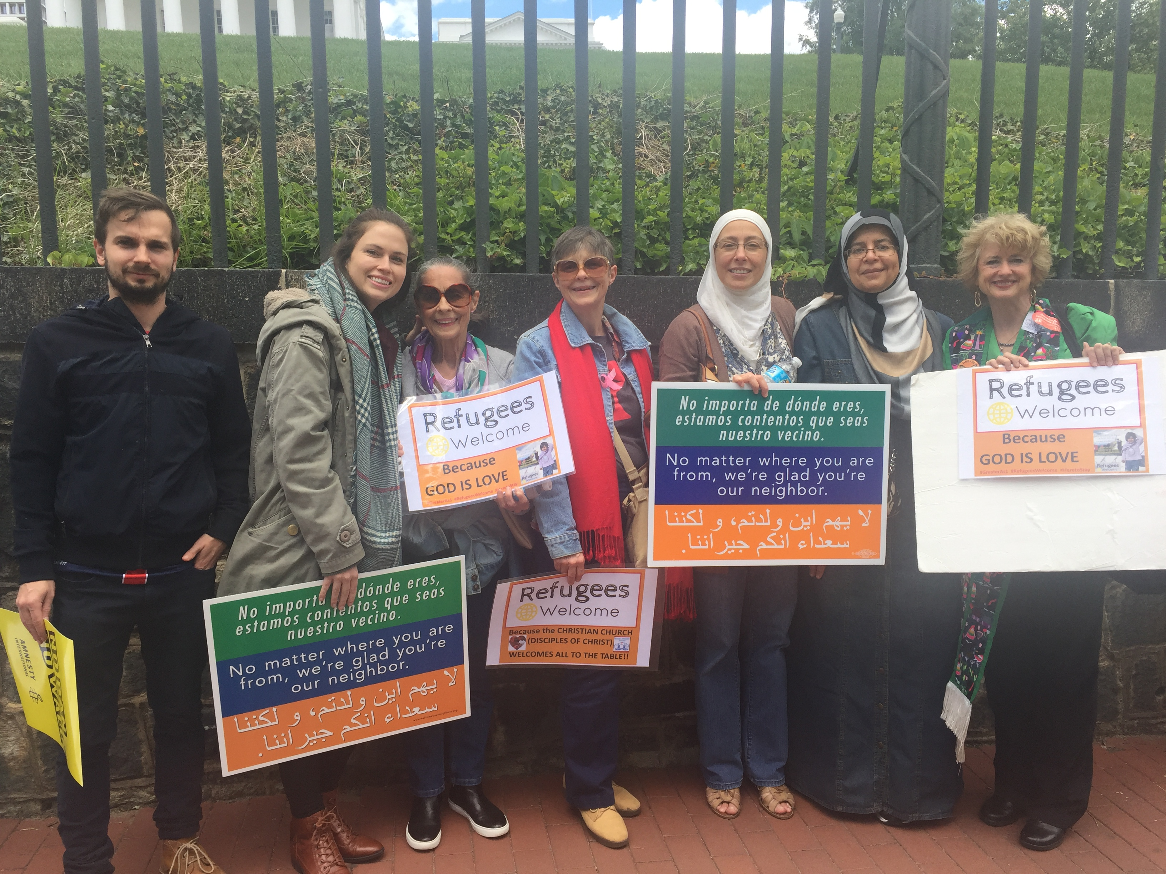

Slide 23
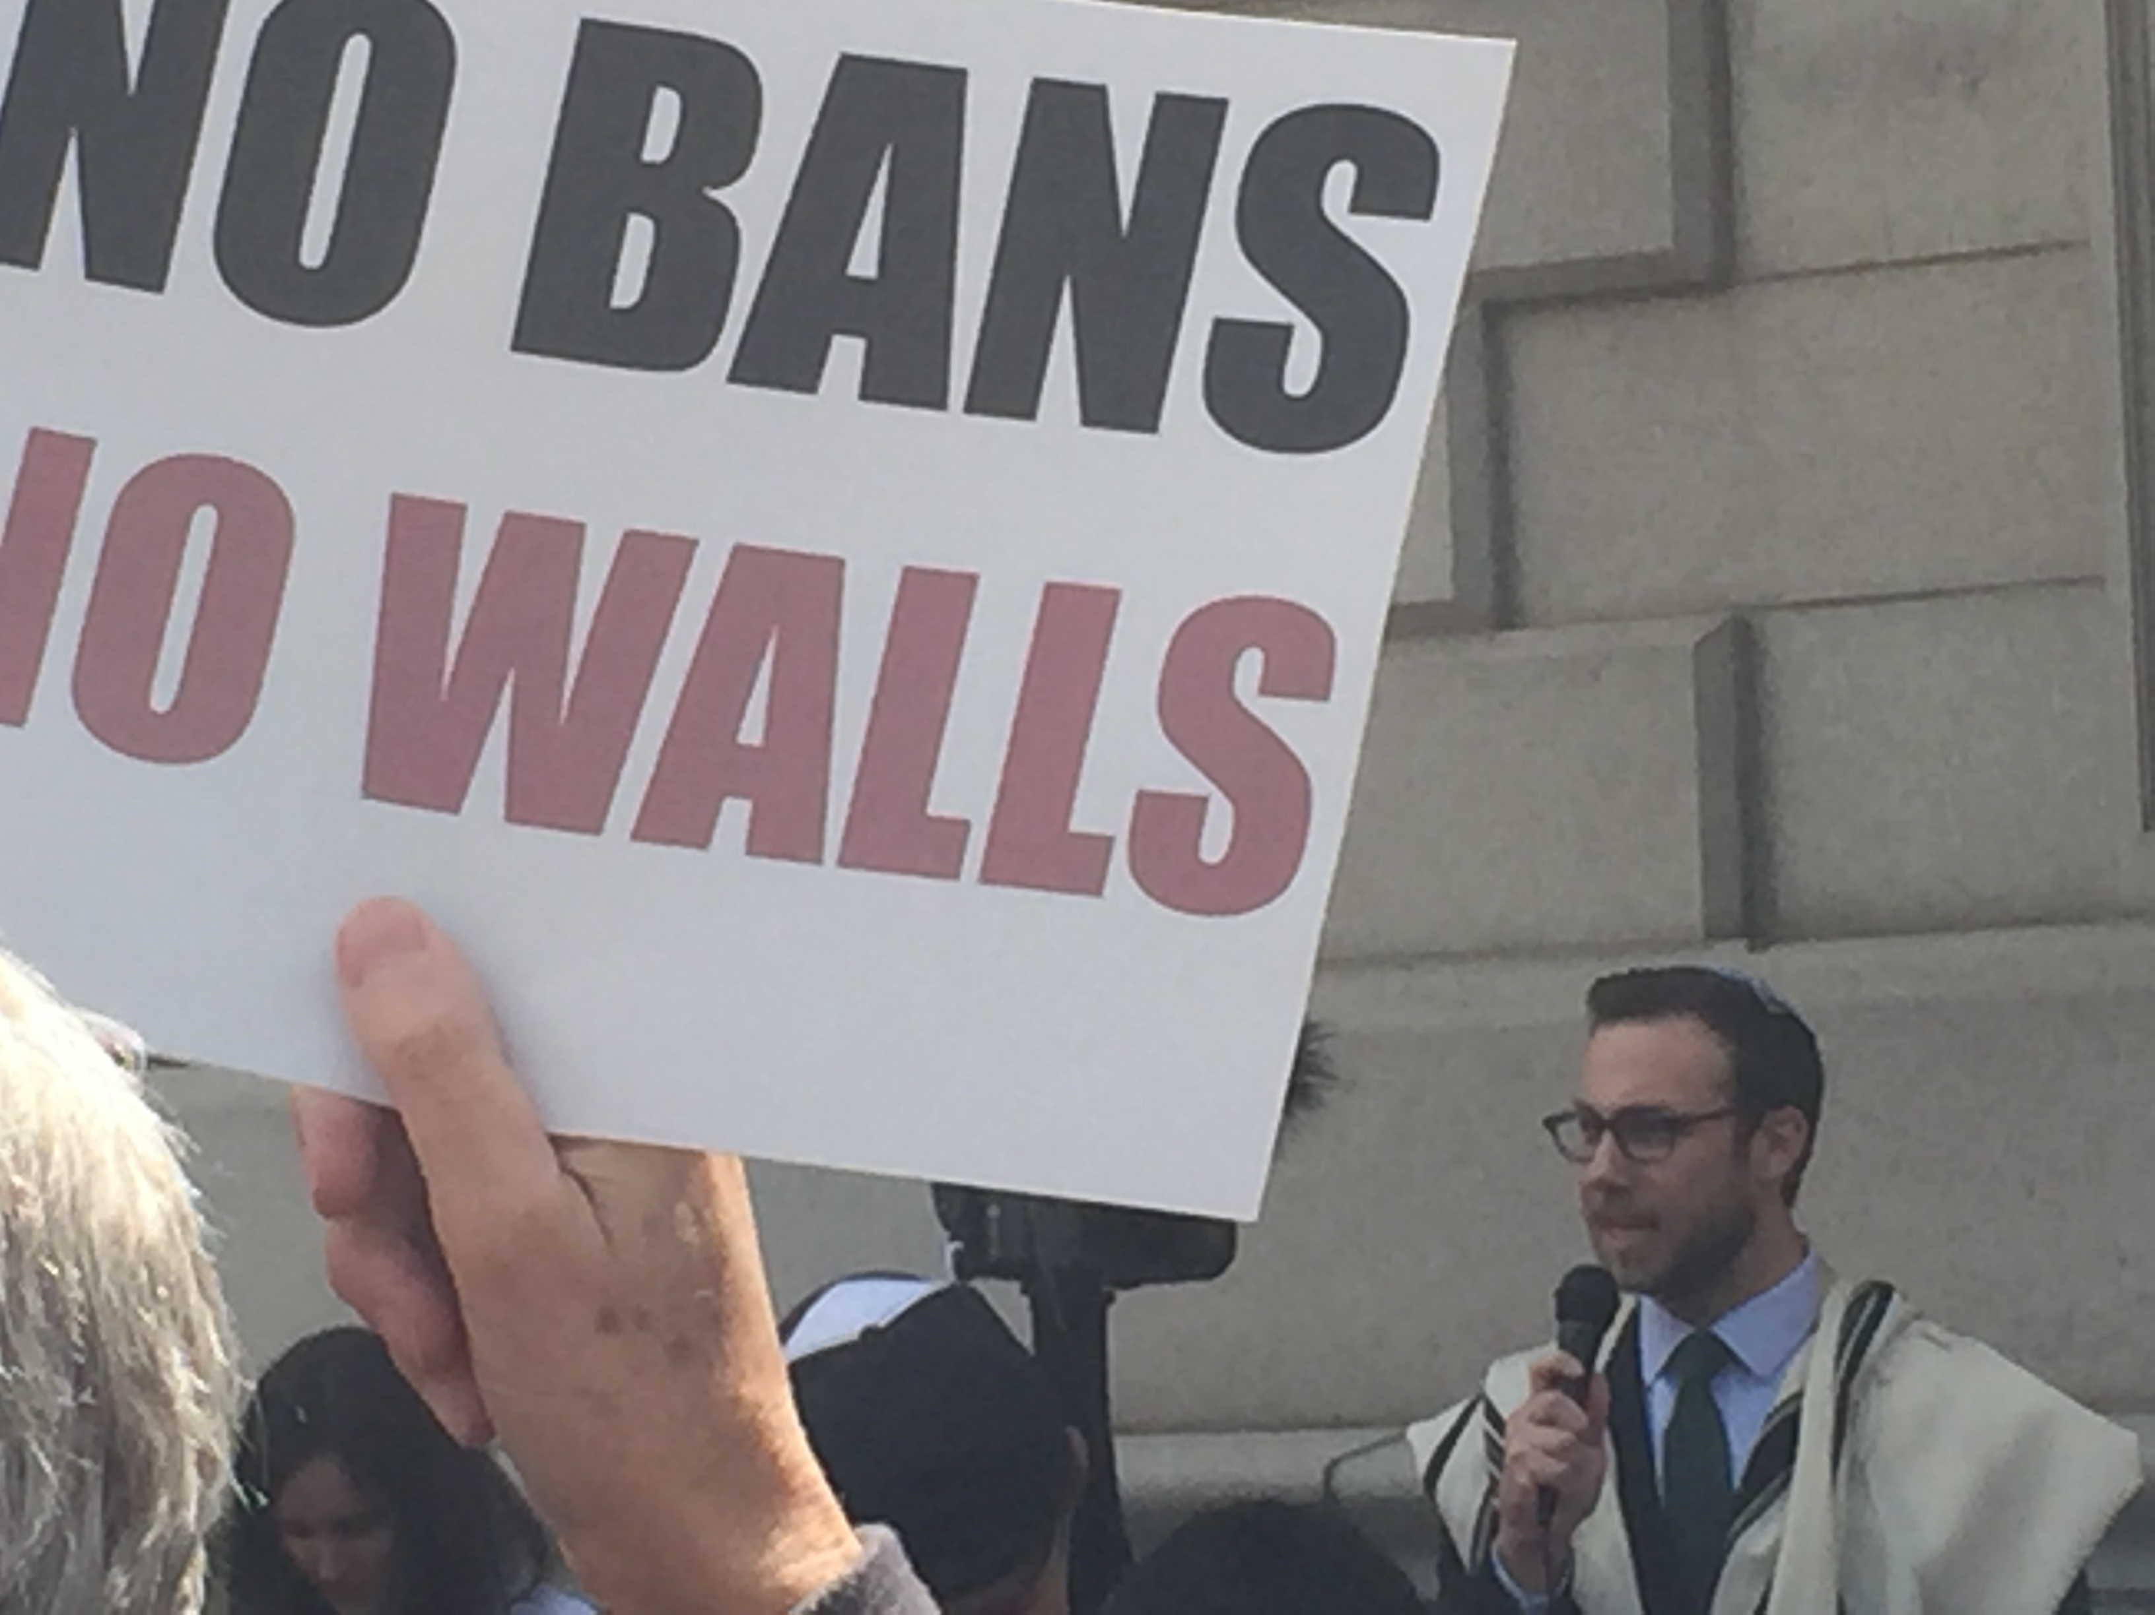

Slide 24




Building Up to World
Refugee Day
Honoring Immigrant & Refugee Moms and Dads
Interfaith Immigration Coalition
*Light a Candle for Moms
*Stories of Moms
*Links to Immigrant/Refugee
*Solidarity Actions
https://mamasday.org/
http://www.interfaithimmigration.org/2016/10/13/religious-holiday-resources/
Pick a Card by an Artist, Sign a Message,
Send Through a Trusted Partner Organization
https://webelongtogether.org/

Slide 25

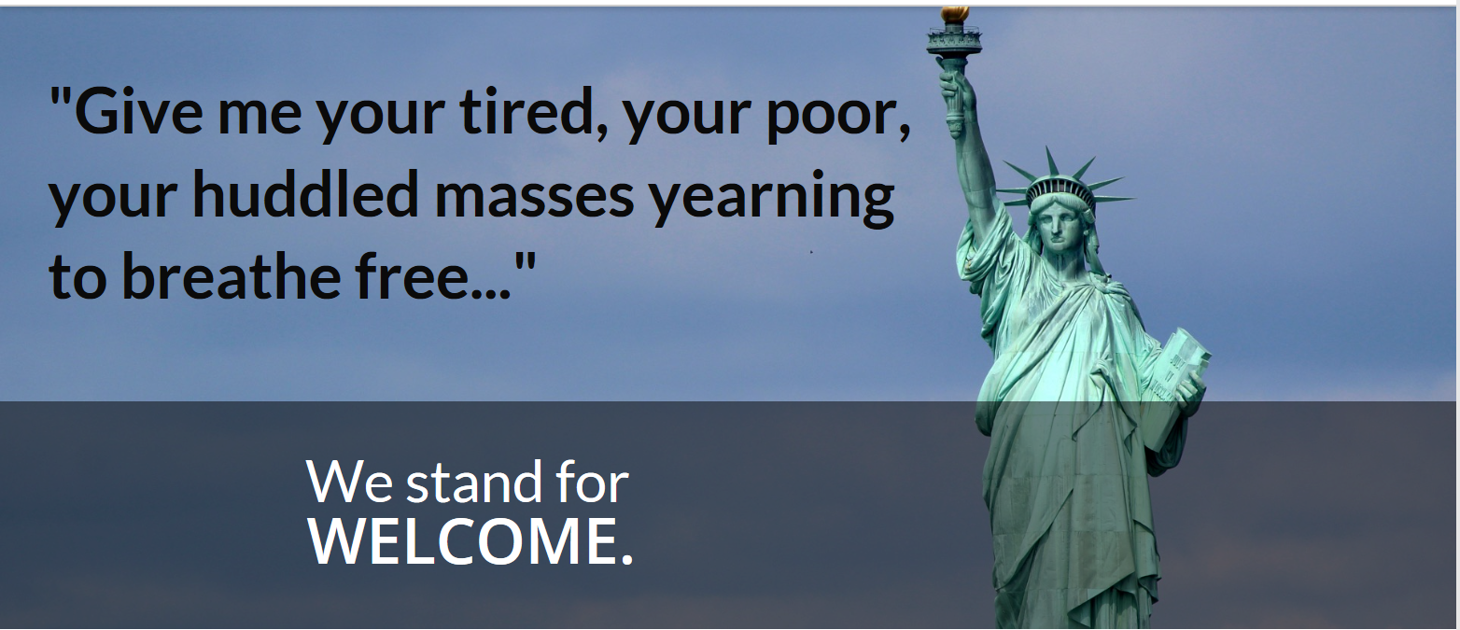
Building Up to World
Refugee Day
CWS & NCC Partner Communions Release “Ecumenical Declaration”
https://greateras1.org/act/congregations/
Hold “Refugee & Immigrant Welcome” worship and events in June!

Slide 26
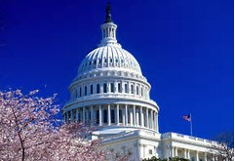
Building Up to World
Refugee Day
“Speak for One” World Refugee Week
Call In Campaign: 100,000 Calls
Especially during June 13-15
*Support Welcome for Refugees
*Request a higher refugee admission number
*Call 3 times: Each Member of Congress—
Ask them to CALL the White House!

Slide 27




Building Up to World
Refugee Day
Sign and Deliver Refugees Welcome Legislator Postcards
Purchase Refugees Welcome Door Hangers & Bracelets
Refugeesarewelcome.org

Slide 28
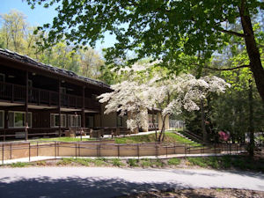

Building Up to World
Refugee Day
Introduce Special Refugee/Immigrant Events & Resolutions at Your
Faith Conferences & Camps!!

Slide 29


Slide 30


Slide 31


Slide 32


Slide 33


Slide 34
QUESTIONS AND ANSWERS

Slide 35
IIC Contacts by organization
Jewish Council for Public Affairs: Krissy Roth, kroth@thejcpa.org
Leadership Conference of Women Religious: Ann Scholz, SSND ascholz@lcwr.org
Lutheran Immigration and Refugee Service: McKayla Eskilson, meskilson@lirs.org
Maryknoll Office for Global Concerns: Judy Coode, jcoode@maryknoll.org
Mennonite Central Committee U.S.: Tammy Alexander, TammyAlexander@mcc.org
Muslim Public Affairs Council: Hoda Elshishtawy, hoda@mpac.org
Sisters of the Good Shepherd: Larry Couch, lclobbyist@gsadvocacy.org
National Council of Churches: Russell Meyer, rmeyer@floridachurches.org
National Council of Jewish Women: Faith Fried, Faith@ncjwdc.org
National Justice for Our Neighbors: Rob Rutland-Brown, rob@njfon.org
NETWORK Lobby: Laura Peralta-Schulte, LPeralta@networklobby.org
Pax Christi: Anne-Louise Nadeau, anadeau@paxchristiusa.org
PICO: Rich Morales rmorales@piconetwork.org
Presbyterian Church, USA: Teresa Waggener, Teresa.Waggener@pcusa.org
Scalibrinian International Migration Network/Center for Migration Studies: Kevin Appleby; kappleby@cmsny.org
Sisters of Mercy of the Americas: Jean Stokan, jstokan@sistersofmercy.org
Sojourners: Michael Mershon mmershon@sojo.net
T’ruah: The Rabbinic Call for Human Rights: Rabbi Rachel Kahn-Troster, rkahntroster@truah.org
Union for Reform Judaism: Shelby Friedman, sefriedman@rac.org
Unitarian Universalist Association: Susan Leslie, SLeslie@uua.org
Unitarian Universalist Service Committee: Hannah Hafter, hhafter@uusc.org
United Church of Christ: Jason Carson Wilson, wilsonj@ucc.org
United Methodist Church: Jeania Ree Moore, jmoore@umc-gbcs.org
UNITED SIKHS: Anisha Singh, anisha.singh@unitedsikhs.org
U.S. Conference of Catholic Bishops: Todd Scribner, tscribner@usccb.org
World Relief: Jenny Hwang, jhwang@worldrelief.org
African American Ministers in Action: Leslie Malachi, lmalachi@pfaw.org
American Baptist Home Mission Societies of the American Baptist Churches, USA: Brenda Halliburton, brenda.halliburton@abhms.org
American Friends Service Committee: Kathryn Johnson, kjohnson@afsc.org
American Jewish Committee: Richard Foltin, foltinr@ajc.org
Bread for the World Institute: Marco Grimaldo, mgrimaldo@bread.org
Christian Church (Disciples of Christ): Sharon Stanley, sstanley@dhm.disciples.org
Christian Reformed Church: Kelsey Herbert, kherbert@crcna.org
Church of the Brethren: Nate Hosler, nhosler@brethren.org
Church World Service: Jen Smyers, jsmyers@cwsglobal.org
CLINIC: Michelle Sardone, msardone@cliniclegal.org
Columban Center for Advocacy and Outreach: Rebecca Eastwood, reastwood@columban.org
Conference of Major Superiors of Men: Eli McCarthy, emccarthy@cmsm.org
Daughters of Charity: Mary Ellen Lacy, Maryellen.lacy@doc.org
Episcopal Church: Lacy Broemel, lbroemel@episcopalchurch.org
Evangelical Lutheran Church in America: Alaide Vilchis Ibarra, Alaide.Ibarra@elca.org
Franciscan Action Network: Marie Lucey, lucey@franciscanaction.org
Friends Committee on National Legislation: Hannah Evans, hannah@fcnl.org
HIAS: Liza Lieberman, liza.lieberman@hias.org
Ignatian Solidarity Network: Christopher Kerr, ckerr@ignatiansolidarity.net
Interfaith Worker Justice: Laura Barrett lbarrett@iwj.org
Irish Apostolate USA: Marie Prefontaine, coordinator@usairish.org
Jesuit Conference of Canada and the U.S.: Kristen Lionetti, klionetti@jesuits.org
Jesuit Refugee Service/USA: Guilia McPherson, gmchperson@jesuits.org

