Slide 1
interfaithimmigration.org
Welcome to this month’s Webinar on
Deferred Action for Childhood Arrivals (DREAMer Relief)
Thursday, August 16th, 2012
Call and Webinar will begin at 3:30p.m. EDT
Please dial 218-936-4700 and enter 657758
The audio & visual portions are NOT linked. You must dial this number to hear the audio for the webinar.

Slide 2
AGENDA
3:30 Welcome & Introductions (please use chat function)
3:35 Overview of call, purpose
3:40 Kelly Ryan, Acting Deputy Assistant Secretary for Immigration Policy, Department of Homeland Security – with Q&A
4:00 Shiu-Ming Cheer, Immigration Attorney, National Immigration Law Center – with Q&A
4:10 Evelyn Rivera, Organizer, United We Dream Network
4:20 Liz Balck, Regional Attorney, Justice for Our Neighbors West Michigan
4:30 Jenn Piper, Interfaith Organizing Director for Immigrant Rights, American Friends Service Committee
4:40 Tara Pinkham, Immigration Attorney, Church World Service
4:45 Noel Andersen, Grassroots Organizer, Church World Service
4:50 Questions, ideas & brainstorming

Slide 3
What is Deferred Action?
On June 15, 2012, Secretary of Homeland Security Janet Napolitano announced that certain people who came to the U.S. as children and meet several guidelines may request consideration of deferred action for a period of two years, subject to renewal, and would then be eligible for work authorization.
Individuals who receive deferred action will not be placed into removal proceedings or removed from the U.S. DHS can terminate or renew deferred action at any time at the agency’s discretion.
Deferred action is not a permanent status or pathway to citizenship.

Slide 4
RESOURCES
USCIS Website: http://www.uscis.gov/portal/site/uscis/menuitem.eb1d4c2a 3e5b9ac89243c6a7543f6d1a/?vgnextoid=f2ef2f19470f7310VgnVCM100000082ca60aRCRD&vgnextchannel=f2ef2f19470f7310VgnVCM100000082ca60aRCRD#about
5 Ways you can help DREAMers: http://sojo.net/blogs/2012/08/03/five-ways-you-can-help-dreamers-find-relief
United We DREAM Map: http://unitedwedream.org/resources/deferred-action/community-education-forum/
New Online Tool Will Provide Legal Help to Thousands of DREAMers: Heartland Alliance’s National Immigrant Justice Center will launch DREAMerJustice.org, a self-assessment tool to enable eligible youth to apply for the Obama administration’s initiative offering temporary relief from deportation. DREAMerJustice.org will be available on August 15.
Compiled additional resources: supportimmigrationreform.org

Slide 5
Limitations
    Will be granted only for 2 years and may be extended at discretion of administration
    Deferred Action does not confer any immigration status
    It does not provide a pathway to permanent residence or citizenship
    It can be revoked at any time
    No appeal process

Slide 6
Who Qualifies?
Individuals who:
Arrived to the United States before the age of sixteen
Have continuously resided within the U.S. for at least five years prior to June 15, 2012 (from June 15, 2007 - to the present time)
Were physically present in the U.S. on June 15, 2012, and at the time of filing for deferred action with USCIS
Are currently in school, have graduated from high school, have obtained a general education development certificate (GED), or is an honorably discharged veteran of the Coast Guard or armed forces of the U.S.
Have not been convicted of a felony or significant misdemeanor
Do not pose a threat to public safety or national security
Were under the age of 31 as of June 15, 2012

Slide 7
Entry to the United States before the age of sixteen
Date of entry can be shown through:
Financial records, medical records, school records, employment records, and military records
Plane, bus or train tickets
Passport stamp
Photographs
Affidavits of knowledgeable individuals

Slide 8
Were physically present in U.S. on June 15, 2012, and at the time of filing for deferred action with USCIS
Physical presence on June 15, 2012:
Financial records, medical records, school records, employment records, and military records
Bank deposit slips
Affidavits of knowledgeable individuals
Photographs

Slide 9
Have continuously resided in U.S. for at least 5yrs. prior to June 15, 2012 (from June 15, 2007 - to the present time)
Continuous Residence:
Financial records, medical records, school records, employment records, and military records
Photographs
Affidavits of knowledgeable individuals

Slide 10
Education & Military Requirements
Education:
Diploma or GED certificates
Official School Transcripts
Report Cards
Military:
report of separation forms
military personnel records
military health records

Slide 11
Have continuously resided in U.S. for at least 5yrs. prior to June 15, 2012 (from June 15, 2007 - to the present time)
Do brief departures from the United States interrupt the continuous residence requirement?
A brief, casual, and innocent absence from the United States will not interrupt your continuous residence. If you were absent from the United States for any period of time, your absence will be considered brief, casual, and innocent, if it was before August 15, 2012, and:
1. The absence was short and reasonably calculated to accomplish the purpose for the absence;
2. The absence was not because of an order of exclusion, deportation, or removal;
3. The absence was not because of an order of voluntary departure, or an administrative grant of voluntary departure before you were placed in exclusion, deportation, or removal proceedings; and
4. The purpose of the absence and/or your actions while outside the United States were not contrary to law.
*Taken from: USCIS Deferred Action for Childhood Arrivals website*

Slide 12
No Felony Convictions & Misdemeanor Offenses
If you have been convicted of a felony offense, a significant misdemeanor offense, or three or more other misdemeanor offenses not occurring on the same date and not arising out of the same act, omission, or scheme of misconduct, you will not be considered for deferred action under the new process except where DHS determines there are exceptional circumstances.
Felony:
A federal, state, or local criminal offense punishable by imprisonment for a term exceeding one year.

Slide 13
No Felony Convictions & Misdemeanor Offenses
Significant Misdemeanor:
A misdemeanor as defined by federal law (specifically, one for which the maximum term of imprisonment authorized is one year or less but greater than five days) and that meets the following criteria:
Regardless of the sentence imposed, is an offense of domestic violence; sexual abuse or exploitation; burglary; unlawful possession or use of a firearm; drug distribution or trafficking; or, driving under the influence; or,
2. If not an offense listed above, is one for which the individual was sentenced to time in custody of more than 90 days. The sentence must involve time to be served in custody, and therefore does not include a suspended sentence.

Slide 14
No Felony Convictions & Misdemeanor Offenses
Non-significant misdemeanor:
Any misdemeanor as defined by federal law (specifically, one for which the maximum term of imprisonment authorized is one year or less but greater than five days) and that meets the following criteria:
Is not an offense of domestic violence; sexual abuse or exploitation; burglary; unlawful possession or use of a firearm; drug distribution or trafficking; or, driving under the influence; and
2. Is one for which the individual was sentenced to time in custody of 90 days or less.
*Taken from: USCIS Deferred Action for Childhood Arrivals website*

Slide 15
No Felony Convictions & Misdemeanor Offenses
Other misdemeanors:
A minor traffic offense will not be considered a misdemeanor for purposes of this process.
Immigration-related offenses characterized as felonies or misdemeanors by state immigration laws will not be treated as disqualifying felonies or misdemeanors for the purpose of considering a request for consideration of deferred action pursuant to this process.
Expunged convictions and juvenile convictions will be assessed on a case-by-case basis . If you were a juvenile, but tried and convicted as an adult, you will be treated as an adult for purposes of the deferred action for childhood arrivals process.

Slide 16
Pose No Threat to Public Safety or National Security
Indicators that show pose of threat include, but are not limited to:
gang membership
participation in criminal activities
participation in activities that threaten the United States

Slide 17
Criminal Background Checks
Background checks involve checking biographic and biometric information provided by the individuals against a variety of databases maintained by DHS and other federal government agencies (USCIS website)
Virginia: http://www.vsp.state.va.us/CJIS_Criminal_Record_Check.shtm
(Does not require fingerprints)
FBI: http://www.fbi.gov/about-us/cjis/background checks/background_checks
(Requires fingerprints )
Driving History: http://www.dmv.virginia.gov/webdoc/citizen/records/drive_record.asp
Certified Court Dispositions: contact the Court that issued
Judgment.
*Taken from http://www.bromberglaw.com/wp-content/uploads/2012/07/DREAMers-vr2.pdf*

Slide 18
Employment Authorization
File application with USCIS
Filing fee for employment authorization and biometrics will total $465
Fee waivers will not be available for employment authorization applications, but fee exemptions will be available on a very limited basis

Slide 19
Demonstrate Economic Necessity
Information about and proof of monthly income and expenses
Bills, account statements and receipts
Employment records and pay stubs if appropriate
USCIS in the past has been reasonable about this requirement
*Taken from http://www.bromberglaw.com/wp-content/uploads/2012/07/DREAMers-vr2.pdf*

Slide 20

Filing Process
Beginning August 15, 2012, applications can be submitted for consideration to USCIS for:
Deferred action
employment authorization
The total USCIS fees will be $465.

Slide 21
Other Filing Processes
If you are subject to a final order of removal, contact U.S. Citizenship and Immigration Services (USCIS) at http://www.uscis.gov, or call the USCIS hotline at 1-800-351-4024 (9am – 5pm)
If you are detained by U.S. Immigration and Customs Enforcement (ICE), contact ICE at http://www.ice.gov, or call the ICE hotline at 1-888-351-4024 (9am – 5pm)
If you have never been apprehended or placed into removal proceedings, contact U.S. Citizenship and Immigration Services (USCIS) at http://www.uscis.gov, or call the USCIS hotline at 1-800-351-4024 (9am – 5pm)
To report notario or attorney fraud please click on the following link to find out how to protect yourself and others: http://www.stopnotariofraud.org or http://www.parefraudenotraial.org
Additional resources and frequently asked questions (FAQs) from U.S.. Citizenship and Immigration Services (USCIS) can be found here: http://cfor.cc/USCIS-DA-Guidelines
*Taken from: http://www.fairimmigration.org/projects/deferredaction/*

Slide 22
Legal Assistance
Ways to find legal assistance:
A website — www.weownthedream.org — serves as a clearinghouse for information on deferred action, including:
  an online self-screening tool to determine whether you are eligible for deferred action
  links to pro bono and low bono legal service providers
  a calendar of community forums and workshops
    August 25th National Day of Action: clinics, workshops and community forums will be held around the country.

Slide 23
Legal Assistance
Call the hotline — 1-855-DREAM-D-1 / 855-DREAM-31 — to get answers about deferred action.
Contact your local immigrant youth organization or another immigrant rights group in your community and ask them to refer you to a licensed, reputable lawyer.
Use the American Immigration Lawyers Association’s directory - http://www.ailalawyer.com/ - to find a lawyer.

Slide 24
Be aware of immigration scams
Only a licensed lawyer or accredited representative is authorized and qualified to assist you with your immigration case.
Check whether an immigration lawyer is licensed and in good standing by contacting your state bar or state Supreme Court.
Accredited representatives must be authorized by the BIA. Only those recognized organizations appearing on the http://www.justice.gov/eoir/statspub/raroster.htm list are allowed to help with immigration matters.
It is against the law for notaries to provide immigration advice
  Immigration advice includes filling out forms or an application.
If you have been scammed out of money by a lawyer or notario, visit www.uscis.gov/avoidscams or www.stopnotariofraud.org.

Slide 25
Legal Assistance
National Immigration Law Center: www.nilc.org
Catholic Immigration Network: cliniclegal.org
Justice For Our Neighbors: justiceforourneighbors.org
United We Dream: unitedwedream.org
Immigrant Legal Resource Center: ilrc.org
Ayuda: ayudainc.org
National Immigrant Justice Center: DREAMerJustice.org
American Immigration Council: americanimmigrationcouncil.org
Church World Service: churchworldservice.org/assistancetodreamers
Legal Directory of Immigrant Advocates Network: immigrationadvocates.org

Slide 26
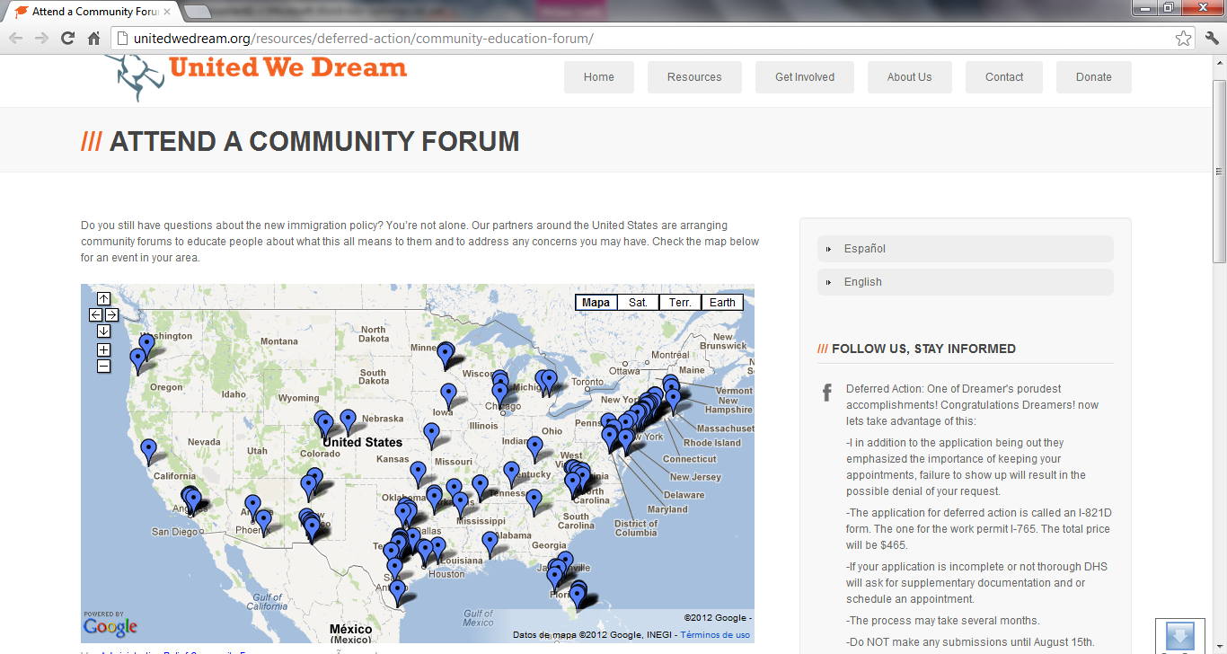
United We DREAM
Map of Community Forums!

Slide 27
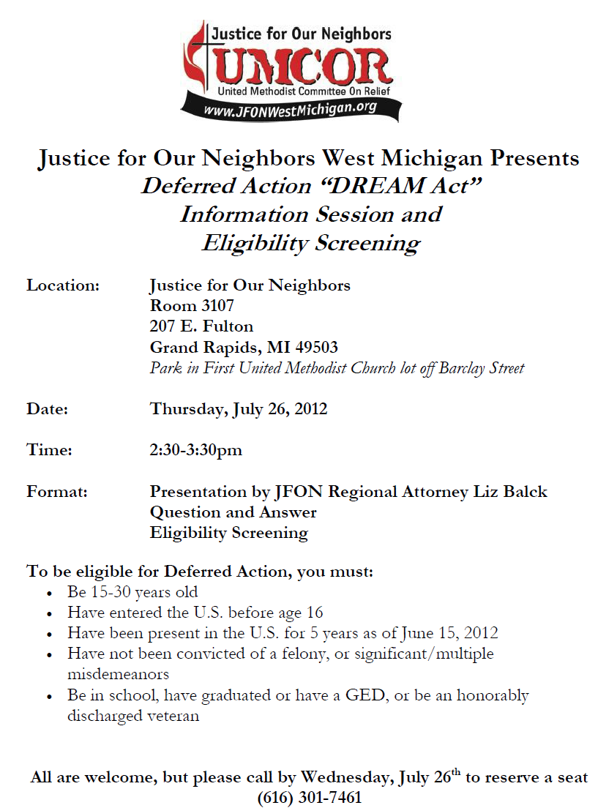

Slide 28
JFON West Michigan & Southeast Michigan’s collaborative efforts
Strong coordination among local non-profit legal service providers across the state
Recruitment of volunteer attorneys through AILA and the Michigan State Bar Association
Recruitment of non-attorney volunteers (JFON is volunteer-based, so we can draw from an already existing roster)
Offer training to attorneys who may not practice immigration law
Offer training to non-attorneys to ensure confidentiality and prevent even the unintentional unauthorized practice of law

Slide 29
Intake/Screening Logistics
Intakes are held prior to workshops on an individual basis (not group format)
Attorneys/BIA reps discuss potential risks associated with filing and flag any potential roadblocks
Referral to private bar if “over-income”
If the applicant is ready to move forward, the attorney/rep will direct a volunteer to schedule the applicant for another appointment at an upcoming workshop (using online tool like Google Documents)

Slide 30
Workshop Logistics
Great volunteer opportunities
The applicant will sign in with a volunteer
Visit a document review table where a volunteer, using a checklist, will review the applicant’s documentation
The applicant is then paired with a volunteer attorney/rep who will prepare all forms and compile the entire packet
Volunteers will make 1 copy for the applicant and 1 for the host legal services organization
Volunteers will help compile the packets for mailing
Childcare, hospitality, copies of all forms, photocopying provided
Charging nominal fee to recover copy costs
These types of volunteer opportunities can be found at JFON offices located throughout the US, for a list of offices, please visit www.umcor.org/UMCOR/resources then click on NJFON

Slide 31
BEST PRACTICES
Mi Familia Vota is a good first point of contact for clinic workshops and needs volunteers for clinics in Arizona, California, Colorado, Nevada, Florida and Texas. If you live in Colorado contact Jenn at jpiper@afsc.org or 303-623-3464 ext. 5 to volunteer.
If you want to offer a clinic in another state, convene attorneys from AILA, organizations that offer citizenship workshops in your area and immigrant groups.
Be sure to advertise information sessions and clinics to all immigrant communities, not just Latinos.
Many places are doing consecutive clinics.
  Clinic 1: Pre-registration- Reviewing with young adults what documentation people still need to gather, helping them think creatively to prepare, flagging potential issues for lawyers’ review.
  Clinic 2: Registration- Filling out the application, etc. and review by a lawyer.

Slide 32
How can congregations help?
As a congregation leader or volunteer you should not provide legal advice; practice law without authorization, determine an individual’s eligibility for Deferred Action; or answer questions you don’t know
As a congregation leader or volunteer you can:
Host information sessions about Deferred Action
Refer individuals to accredited representatives or attorneys (see list for free and low-cost services)
Link up with an attorney to host a clinic workshop where an attorney reviews applications with DREAMers while the church provides a site and volunteers to help with:
  Registration
  Filling out forms (2 stations) with DREAMers and Screening
  Making Copies of documents and taking photos
  Printing criminal records
  Guiding people to the different stations
  Child Care and much more
  Help individuals gather and translate documents

Slide 33
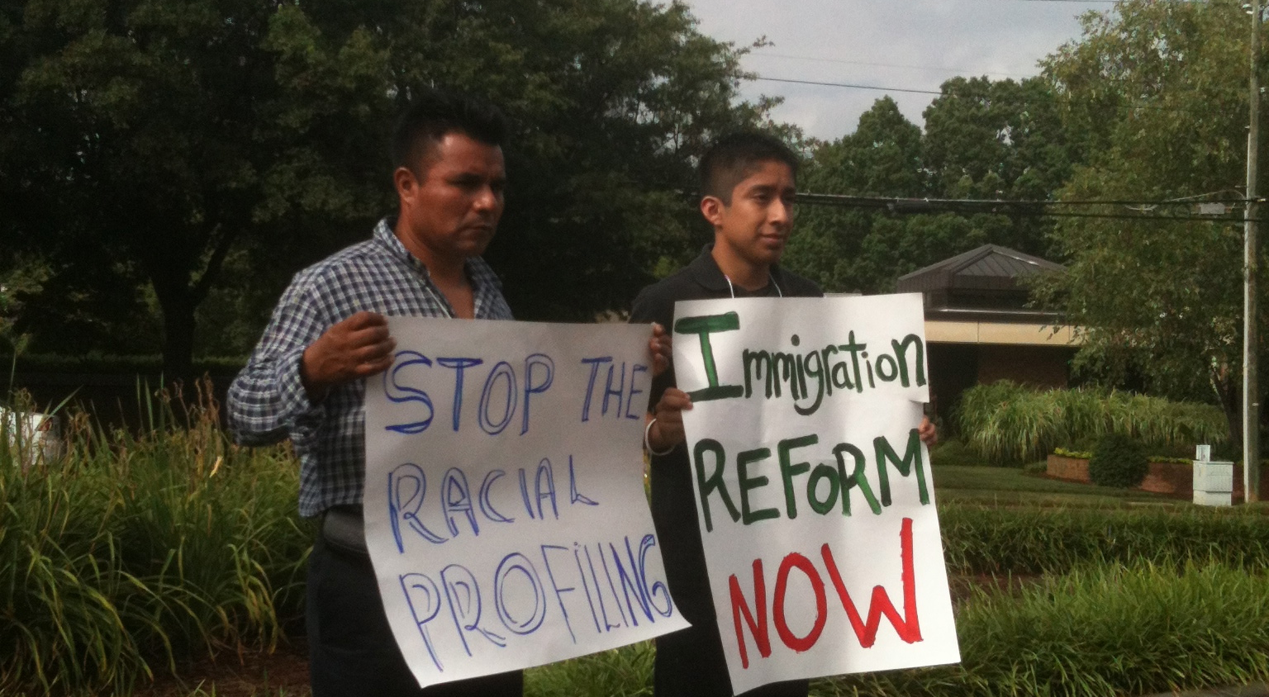
Deferred Action is a Critical Step Forward in the Immigrants’ Rights Movement

Slide 34
Building Towards Just Immigration Reform
Without CIR in 2009, the battle turned stateside on immigration issues with the passing of Arizona’s SB 1070
People of faith are building a stronger and more organized base at the local community level to stop anti-immigrant policies and turn the tide toward local and state immigrant-welcoming policies
We must continue to build teams, educate communities, participate in civic engagement work, and be ready for post 2012-Election possibilities to pass humane immigration reforms

Slide 35

IIC Contacts by organization
African American Ministers in Action: Leslie Malachi, lmalachi@pfaw.org
American Jewish Committee: Chelsea Hanson, hansonc@ajc.org
American Friends Service Committee: Jessica Roach, jroach@afsc.org
Bread for the World Institute: Andrew Wainer, awainer@bread.org
Church World Service: Jen Smyers, jsmyers@churchworldservice.org
Disciples of Christ: Ken Brooker Langston, revkenbl@yahoo.com
Episcopal Migration Ministries: Katie Conway, kconway@episcopalchurch.org
Franciscan Action Network: Patrick Carolan, pcarolan@franciscanaction.org
Friends Committee on National Legislation: Ruth Flower, flower@fcnl.org
Hebrew Immigrant Aid Society: Liza Lieberman, liza.lieberman@hias.org
Interfaith Worker Justice: Thomas Shellabarger, tshellabarger@iwj.org
Irish Apostolate USA: Geri Garvey, administrator@usairish.org
Islamic Information Center: Hajar Hosseini, hosseini@islamicinformationcenter.org
Jesuit Refugee Service/USA, Shaina Aber, saber@jesuit.org
Jewish Council for Public Affairs: Elyssa Koidin, ekoidin@thejcpa.org
Lutheran Immigration and Refugee Service: Nora Skelly, nskelly@lirs.org
Mennonite Central Committee: Tammy Alexander, talexander@mcc.org
Muslim Public Affairs Council: Hoda Elshishtawy, hoda@mpac.org
Sisters of the Good Shepherd: Larry Couch, lclobbyist@gsadvocacy.org
NETWORK: Sr. Mary Ellen Lacy, D.C., melacy@networklobby.org
Pax Christi: Scott Wright, scott@tassc.org
PICO: Michele Rudy, michelerudy@yahoo.com
Presbyterian Church, USA: Melissa Gee, melissa.gee@pcusa.org
Sisters of Mercy of the Americas: Regina McKillip, rmckillip@sistersofmercy.org
Sojourners: Ivone Guillen, iguillen@sojo.net
Union for Reform Judaism: Amelia Viney, aviney@rac.org
Unitarian Universalist Association: Craig Roshaven, croshaven@uua.org
United Church of Christ: Rev. Mari Castellanos, castellm@ucc.org
United Methodist Church: Bill Mefford, bmefford@umc-gbcs.org
UNITED SIHKS: Harpreet Singh, harpreet.singh@unitedsikhs.org
U.S. Conference of Catholic Bishops: Kevin Appleby, kappleby@usccb.org
World Relief: Jenny Yang, jgyang@worldrelief.org

