Slide 1
Interfaithimmigration.org
Welcome to this month’s Webinar on
Neighbor-to Neighbor visits
Monday, March 04th, 2012
Call and Webinar will begin at 4:00 p.m. EST
For audio, please dial 805-399-1000 and enter access code 104402. The audio and visual portions are NOT linked. You must dial this number to hear the audio portion of the webinar.

Slide 2
AGENDA
4:00 Welcome & overview of call
4:05 Federal and State Updates, Detainees Release Update
4:15 How to set up Neighbor-to-Neighbor visits
4:25 Available Resources (Go though toolkit online)
4:30 Updates from the Field: Success stories on neighbor to neighbor visits
4:45 Q&A
4:55 Conclude

Slide 3
Federal Updates
Senate Version of the Violence Against Women Act passes the House, sent to Obama for signature
Bi-Partisan Efforts on Immigration Reform continue despite the Sequester Battle: The “Gang of 8” met three times last week. McCain, Flake and Graham briefed the House last Thursday
Detainee Release: In anticipation of the upcoming sequester—Immigration released several hundred immigrants from their detention facilities

Slide 4
State Updates
Tuition Equity/ In-state Tuition
KS- defending current policy of in-state tuition
PA- Bipartisan bill introduced by Sen. Smucker
CO- Senate Passes Tuition Equity Bill
OR- House Passes Tuition Equity Bill
NY -financial aid for undocumented
IN roll-back in-state tuition to cover more students retroactively
DACA and Eligibility for State Drivers License (DL):
AZ Bill introduced for to give DL to DACA
MI now provides DL for DACA
NC introduced bill to keep “No Lawful Status” from being printed on DACA DL

Slide 5
State Updates
Resolutions for Common Sense Immigration Reform:
States: CA, FL,NJ,TX, NV
Cities: Boston, Philly, Pima County, Providence, San Juan
Already Passed: Tucson, Riversid,e Cudahy, El Paso, El Paso County
Anti-Immigrant laws
Arizona introduces SB 1120, to repeal SB 1070
Drivers License for Undocumented
IL Passed
KY Passed Senate
OR, CA, TX
TRUST Act
CA, MA, CT, WA

Slide 6
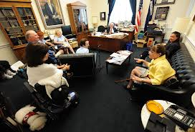
What are Neighbor-to-Neighbor Visits?
When members of Congress know their constituents care about immigrants’ rights, they vote accordingly.
Bringing together a delegation of faith and community leaders to establish and nurture relationships with your senators and representatives is crucial to enacting humane immigration reform.
Every senator and representative has an office – often multiple offices – in their home states.
This is a convenient opportunity to make your voice heard. Neighbor-to-Neighbor visits are meetings that you and others in your community set up with your members of Congress and their staff to urge them to support humane immigration reform.

Slide 7
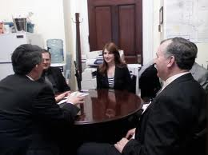
What are Neighbor-to-Neighbor Visits?
Visit and connect with your senators & representatives in their home offices to:
Voice your concerns on issues you care about
Voice the concerns on behalf of those who you work closely with
Have your voice heard and contribute your opinion to the debate

Slide 8
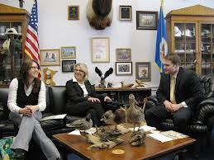
Purpose of Neighbor-to-Neighbor In-District Visits
To persuade your senators and representative to vote for immigration reform that prioritizes family unity and provides a pathway to full citizenship
To put our faith into action to make sure your senators and representative understand that their constituents and people of faith care about immigrants’ rights
To build relationships between people of faith and public officials who make decisions that impact our communities
It is helpful to meet with your senators and representative early on to urge them to support immigration reform based on the principles of full citizenship and family unity and it will also be important to meet with them after an immigration bill is introduced.

Slide 9
Neighbor to Neighbor Visits with Congresspersons and Senators
Organize local neighbor-to-neighbor visits with your senators, representatives, and local decision makers. By linking local congressional visits with DC based visits, we can send a strong message that people of faith care about immigrants’ rights.
Set up meetings with strategic decision makers and coordinate a delegation of faith leaders and/or service providers to meet your members of congress.
Coordinate with IIC advocates in DC so we can compare notes on the visits and identify next steps in ensuring their support for humane immigration reform. You can report on how your visit went at this link:
interfaithimmigration.org/state-resources/register-in-district-visits-to-lawmakers-on-cir
Join and organize local actions such as marches, rallies and press conferences.

Slide 10
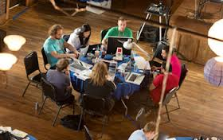
Planning your Neighbor-to-Neighbor Visit
BEFORE THE VISIT
Get a team together
Find out whose vote on immigration is most important in your region
Meet ahead of time or put together a conference call to assign talking points and roles for each participant

Slide 11
Setting Up Your Visit
Make sure to invite higher level religious leaders
Make your group diverse, and try to have someone impacted by these policies present to tell their story
Engage the faith perspective and moral imperative

Slide 12
Research the Key Decision Maker’s Background
Find out the basics of the decision makers background and biography.
Look at his/her faith background and try to have some one from that denomination at the visit
Research their background on immigration, district demographics of Latino voters and campaign contributors

Slide 13
Making the Appointment
Schedule a meeting by emailing the member’s scheduler, find out what days work for your best leaders and suggest those days first. Make sure to give a few dates, since legislators have very busy schedules
Schedule meetings ahead of time, try to get in during a congressional recess or on a Monday or Friday where you might catch the member face to face. The next congressional recess is March 22nd – April 4th.
Push hard for a face to face with member -- if you can’t get one ask for the staff who works on immigration

Slide 14
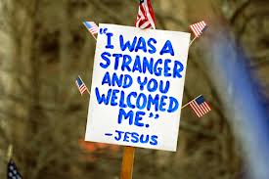
Theological Grounding
Showing hospitality and welcome for newly arrived neighbors is supported by the sacred texts of all faiths, and is rooted in the inherent integrity and humans rights of all individuals. You may want to integrate these and other texts into the content of your visits or to use them to reflect on how important it is to work with our immigrant brothers and sisters and advocate for justice.
The Hebrew Bible teaches that “When immigrants live in your land with you, you must not cheat them. Any immigrant who lives with you must be treated as if they were one of your citizens. You must love them as yourself, because you were immigrants in the land of Egypt; I am the LORD your God.” (Leviticus 19:33-34, Common English Bible)
In Christian Gospel texts, Jesus teaches that in welcoming the sojourner, we welcome Jesus himself. “I was a stranger and you welcomed me” (Matthew 25:35). The ethic between neighbors that Jesus models and teaches for all of his followers to exemplify is found in the Good Samaritan story, when he defines who the good neighbor is as “the one who showed mercy.” (Luke 10:37).
In Islam, the right to migrate is affirmed in the Qur’an verse "Was not the earth of God spacious
enough for you to flee for refuge?" (4:97)

Slide 15
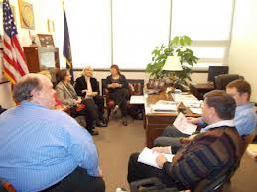
Neighbor-to-Neighbor Visit
During the visit
Suggested Framework:
Introductions
Personal Story
Specific Issue Points
- Path to full citizenship
- Family Unity
- Humanitarian Principles
Make your ask
Leave behind materials
Thank you and invitation to prayer vigil, ESL class, other event

Slide 16
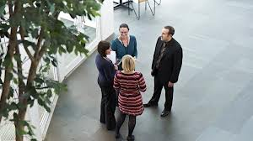
Planning your Neighbor-to-Neighbor Visit
After the Visit:
Debrief your meeting
Communicate with your base
Follow up with your member of Congress
Call Washington DC
Let us know how your visit
went at: www.interfaithimmigration.org/state-resources/register-in-district-visits-to-lawmakers-on-cir.

Slide 17
Share Intel and information with your local coalition and the IIC
The inside information you gather from the meeting can help build your strategy to win their vote for immigration reform
Sharing information helps move forward how we can put pressure on the decision maker at the local and national levels
Information can then be shaped into effective Direct Actions

Slide 18
Neighbor-to Neighbor Visit Toolkits
NEIGHBOR-to-NEIGHBOR VISITS: Visit your senators & representatives in their home offices
  http://www.interfaithimmigration.org/wp-content/uploads/2013/01/IIC_NEIGHBOR_to_NEIGHBOR_Toolkit_01.pdf
Breaking Bread & Building Bridges A campaign to strengthen the movement for just and humane immigration reform
  http://www.interfaithimmigration.org/wp-content/uploads/2012/11/Breaking-Bread-and-Building-Bridges-Intro-2.8.12.pdf
ADVOCACY TOOL KIT ON SECURE COMMUNITIES : HOW TO ORGANIZE AN ADVOCACY MEETING
  http://www.interfaithimmigration.org/wp-content/uploads/2012/08/Advocacy-S-Comm-Tool-Kit-version-5.pdf

Slide 19
Share about your meetings
www.interfaithimmigration.org/state-resources/register-in-district-visits-to-lawmakers-on-cir

Slide 20

IIC Contacts by organization
African American Ministers in Action: Leslie Malachi, lmalachi@pfaw.org
American Jewish Committee: Chelsea Hanson, hansonc@ajc.org
Bread for the World Institute: Andrew Wainer, awainer@bread.org
Church World Service: Jen Smyers, jsmyers@churchworldservice.org
Disciples of Christ: Ken Brooker Langston, revkenbl@yahoo.com
Episcopal Church: Katie Conway, kconway@episcopalchurch.org
Franciscan Action Network: Patrick Carolan, pcarolan@franciscanaction.org
Friends Committee on National Legislation: Ruth Flower, flower@fcnl.org
Hebrew Immigrant Aid Society: Liza Lieberman, liza.lieberman@hias.org
Interfaith Worker Justice: Thomas Shellabarger, tshellabarger@iwj.org
Irish Apostolate USA: Geri Garvey, administrator@usairish.org
Islamic Information Center: Hajar Hosseini, hosseini@islamicinformationcenter.org
Jesuit Refugee Service/USA, Shaina Aber, saber@jesuit.org
Jewish Council for Public Affairs: Elyssa Koidin, ekoidin@thejcpa.org
Lutheran Immigration and Refugee Service: Nora Skelly, nskelly@lirs.org
Mennonite Central Committee: Tammy Alexander, talexander@mcc.org
Muslim Public Affairs Council: Hoda Elshishtawy, hoda@mpac.org
Sisters of the Good Shepherd: Larry Couch, lclobbyist@gsadvocacy.org
NETWORK: Sr. Mary Ellen Lacy, D.C., melacy@networklobby.org
Pax Christi: Scott Wright, scott@tassc.org
PICO: Michele Rudy, michelerudy@yahoo.com
Presbyterian Church, USA: Melissa Gee, melissa.gee@pcusa.org
Sisters of Mercy of the Americas: Regina McKillip, rmckillip@sistersofmercy.org
Sojourners: Ivone Guillen, iguillen@sojo.net
Union for Reform Judaism: Amelia Viney, aviney@rac.org
Unitarian Universalist Association: Craig Roshaven, croshaven@uua.org
United Church of Christ: Rev. Mari Castellanos, castellm@ucc.org
United Methodist Church: Bill Mefford, bmefford@umc-gbcs.org
UNITED SIHKS: Harpreet Singh, harpreet.singh@unitedsikhs.org
U.S. Conference of Catholic Bishops: Kevin Appleby, kappleby@usccb.org
World Relief: Jenny Yang, jgyang@worldrelief.org

