Slide 1
Welcome to this month’s call/webinar on…
How YOU can protect and improve the bipartisan Senate immigration bill (S.744)
Monday, May 6th, 2013
4:00 p.m. EST
For audio, please dial 805-399-1000 and enter access code 104402.
The audio and visual portions are NOT linked. You must dial this number to hear the audio portion of the webinar.
While you’re waiting, check out www.interfaithimmigration.org.

Slide 2
AGENDA
4:00 Welcome & overview
4:05 Discuss potential enforcement and due process amendments
4:15 Discuss potential amendments that would address root causes of migration 4:25 Discuss potential refugee/asylum and family immigration amendments
4:35 Field Update and how YOU can weigh in with elected officials
4:45 Q&A
4:55 Conclude

Slide 3
Enforcement and Due Process
As introduced, the bill would…
Require additional resources for border security, including:
  $6.5 billion in resources, including fencing
  Increased border prosecutions
Enhance government oversight border, including:
  Immigration Ombudsman
  DHS border oversight taskforce
  Use of force policy development
  Increased training
We Need to…
  Encourage Senators to instate a uniform complaint process, fix ATEP and Operation Streamline, allow NGO access to CBP facilities, guarantee due process, and install safe repatriation protocols.
  Urge legislators to address border waiver expansion, number of port-of-entry officers, and accountability of DHS and the National Guard.

Slide 4
Root Causes of Migration
As introduced, the bill would…
…not address root causes of migration!
We need to…
Encourage Senators to address the “push factors” that contribute to unauthorized immigration by investing in sustainable economic development that:
  Targets poverty eradication and sustainable growth
  Prioritizes education, training, and local investment
  Focuses resources on women and girls
Encourage Senators to seek smart, effective ways to reshape the financial systems that unduly burden vulnerable populations.
Make the case that if this legislation is intended to fix the broken immigration system, then we as a country have to truly understand our role and how it impacts the various countries of origin.

Slide 5
Refugees and Asylum
As introduced, the bill would:
Remove the one-year filing deadline for asylum
Keep refugee families together who currently are separated
Improve the efficiency and process of refugee system and special immigrant visa application process
Provide legal status to stateless people
Allow the Administration to designate groups of humanitarian concern who share common characteristics that identify them as targets of persecution as eligible for resettlement
We need to:
  Urge Senators to defend these provisions and vote NO to amendments that could forever prevent vulnerable individuals from seeking asylum or returning to their country of origin for humanitarian causes.
  Make the case that reforming our broken immigration system presents the opportunity to also fix the broken refugee and asylum systems.
  Remind elected officials that the U.S. has a long history of welcoming vulnerable populations – such as refugees and asylees – to our nation.

Slide 6
Family Immigration System
As introduced, the bill would…
More quickly reunite LPRs with their spouses and children
Integrate positive fixes for spouses, fiancées, and minor children of LPRs, as well as stepchildren, widows, orphans, separated kids
Reduce the backlog, recapture unused visas, and increase per-country caps
Permit some family members with approved petitions awaiting green cards to work and live in the U.S. through the “v-visa” program
Allow family members to visit the U.S. for up to 60 days per year
Allow individuals applying for citizenship to include in their applications their spouse and minor children as derivatives.
Introduce two merit-based systems, in addition to family & employment systems
Prevent U.S. citizens from sponsoring their siblings or married kids over 30
We need to…
Urge Senators to ensure that siblings and adult children of U.S. citizens are included in the family provisions of the bill.

Slide 7
How Can I Help???
Funny you should ask…

Slide 8
Participate in the Markup
Senate Judiciary Committee markup dates:
            May 9th
            May 14th
            May 16th
            May 20th-24th
On each morning of the markup, CALL 1-866-940-2439 to hear about amendments and urge your Senators to support or oppose amendments that will impact our communities.
The IIC will send action alerts on the morning of each day with information on what amendments will be considered.
Urge everyone to sign up for alerts at www.interfaithimmigration.org.

Slide 9
Set up Meetings and Events
Memorial Day Recess: May 27th – June 3rd
This is a great time to plan neighbor-to-neighbor visits and to host family unity prayer vigils.
You can also host educational events, film screenings, meet-and-greet events with local immigrant communities, and letter-writing campaigns. The following materials on the IIC website will help in planning your actions, including any media-related outreach:
          IIC Communications Toolkit
          Map of Actions
          Calendar Events
TIP: Whenever possible, try to coordinate your actions and events with local immigrant rights groups.

Slide 10
Sign onto State Letters
State-specific letters of support for these refugee and asylum provisions in S.744:
          Florida (to Senator Rubio)
          California (to Senator Feinstein)
          Texas (to Senators Cornyn and Cruz)
          South Carolina (to Senator Graham)
          Arizona (to Senators McCain and Flake)
          Utah (to Senators Hatch and Lee)
NOTE: We are seeking sign-ons from faith-based, humanitarian, and human rights organizations and leaders.
Deadline for all letters is TOMORROW, Tuesday, May 7th at 5pm EST. Please sign on as an individual or organization (if applicable), and help us widely circulate the letters.
You can sign on directly on the circulated google forms -
contact liza.lieberman@hias.org with questions.

Slide 11
More Helpful Resources
Pay attention to the markup process:
  Learn about the Senate Judiciary Committee
  IIC website – www.interfaithimmigration.org
  IIC facebook page
Continue to educate yourselves and your communities about the bill:
  Compiled statements from faith groups responding to the Senate bill
  Center for American Progress (CAP): Top 10 Ways the Senate’s Immigration Reform Bill Will Fix Our Broken System
  National Immigration Law Center (NILC) Analysis and Summary of the bill
  Alliance for Citizenship (A4C) Analysis of the bill
  Frequently Asked Questions document in Spanish
  Family immigration talking points from the Asian American Justice Center
  Summary from the American Immigration Lawyers’ Association (AILA) and the American Immigration Council (AIC)

Slide 12
General Field Updates
May 1 – On International Labor Day, faith voices around the country joined large mobilizations lifting up the need for immigration reform and immigrant rights. Many Interfaith Services and Vigils accompanied May 1st Events in NM, AL, TX, CA and more.
May 5th Immigrant Rights Sunday – Some traditions have built educational materials around May 1st after the marches in 2006, as International Labor Day has become a central day to recognize the benefits of immigrants to our economy and broader society.
During markup – There will be vigils in DC everyday led by the IIC, Keeping Families Together, and Casa de Maryland. Also daily in-district vigils at Senator Feinstein’s San Francisco office.
May 19th Pentecost Sunday – In Acts 2, the theme of Pentecost lifts up many cultures and languages coming together through a miracle in which all can hear in their own language. This important celebration provides an opportunity to think more about the importance of immigrant justice from a Christian perspective.
· Massachusetts Pentecost Vigil on Immigration
· Texas UMC Preparation for Pentecost Learn to be an Immigration Advocate
· Mennonite Church USA Pentecost Sunday:A witness of Prayer and Faxing
May 21st – Key States Lobby DC Day- SC, TX, UT, AZ
May 28th - June 5th – Nuns on the Border (NJ, PA, DC, VA, NC, SC, GA, FL, AL, LA, TX, NM, AZ, CA)

Slide 13
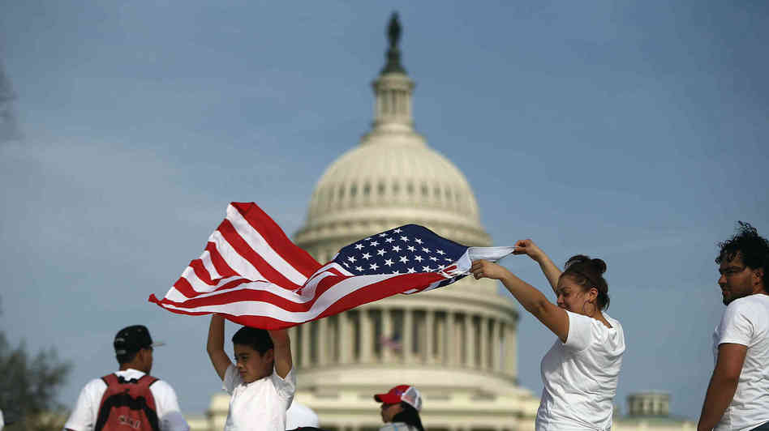
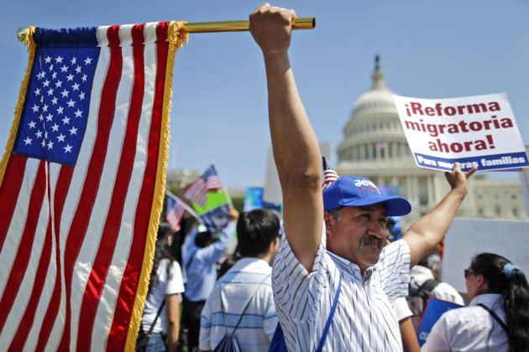
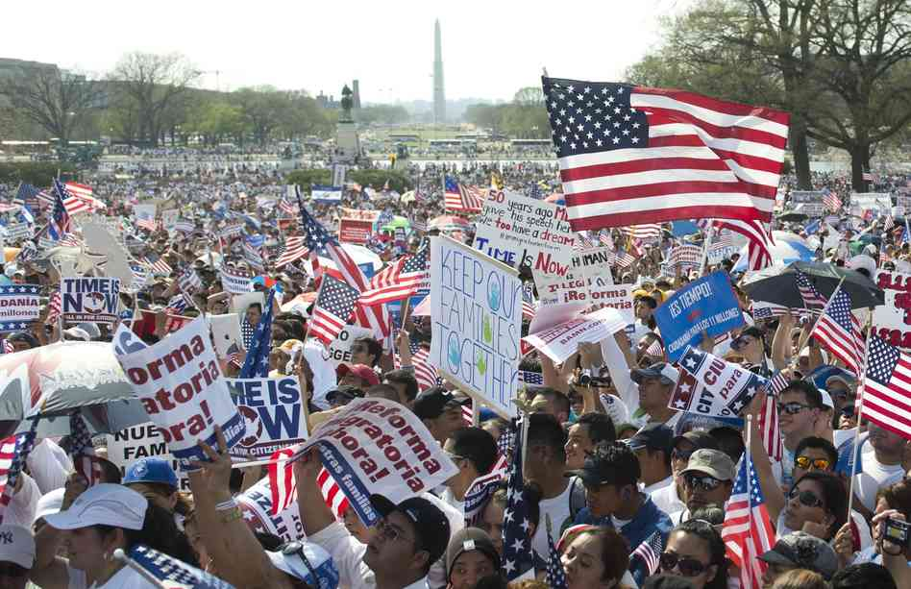
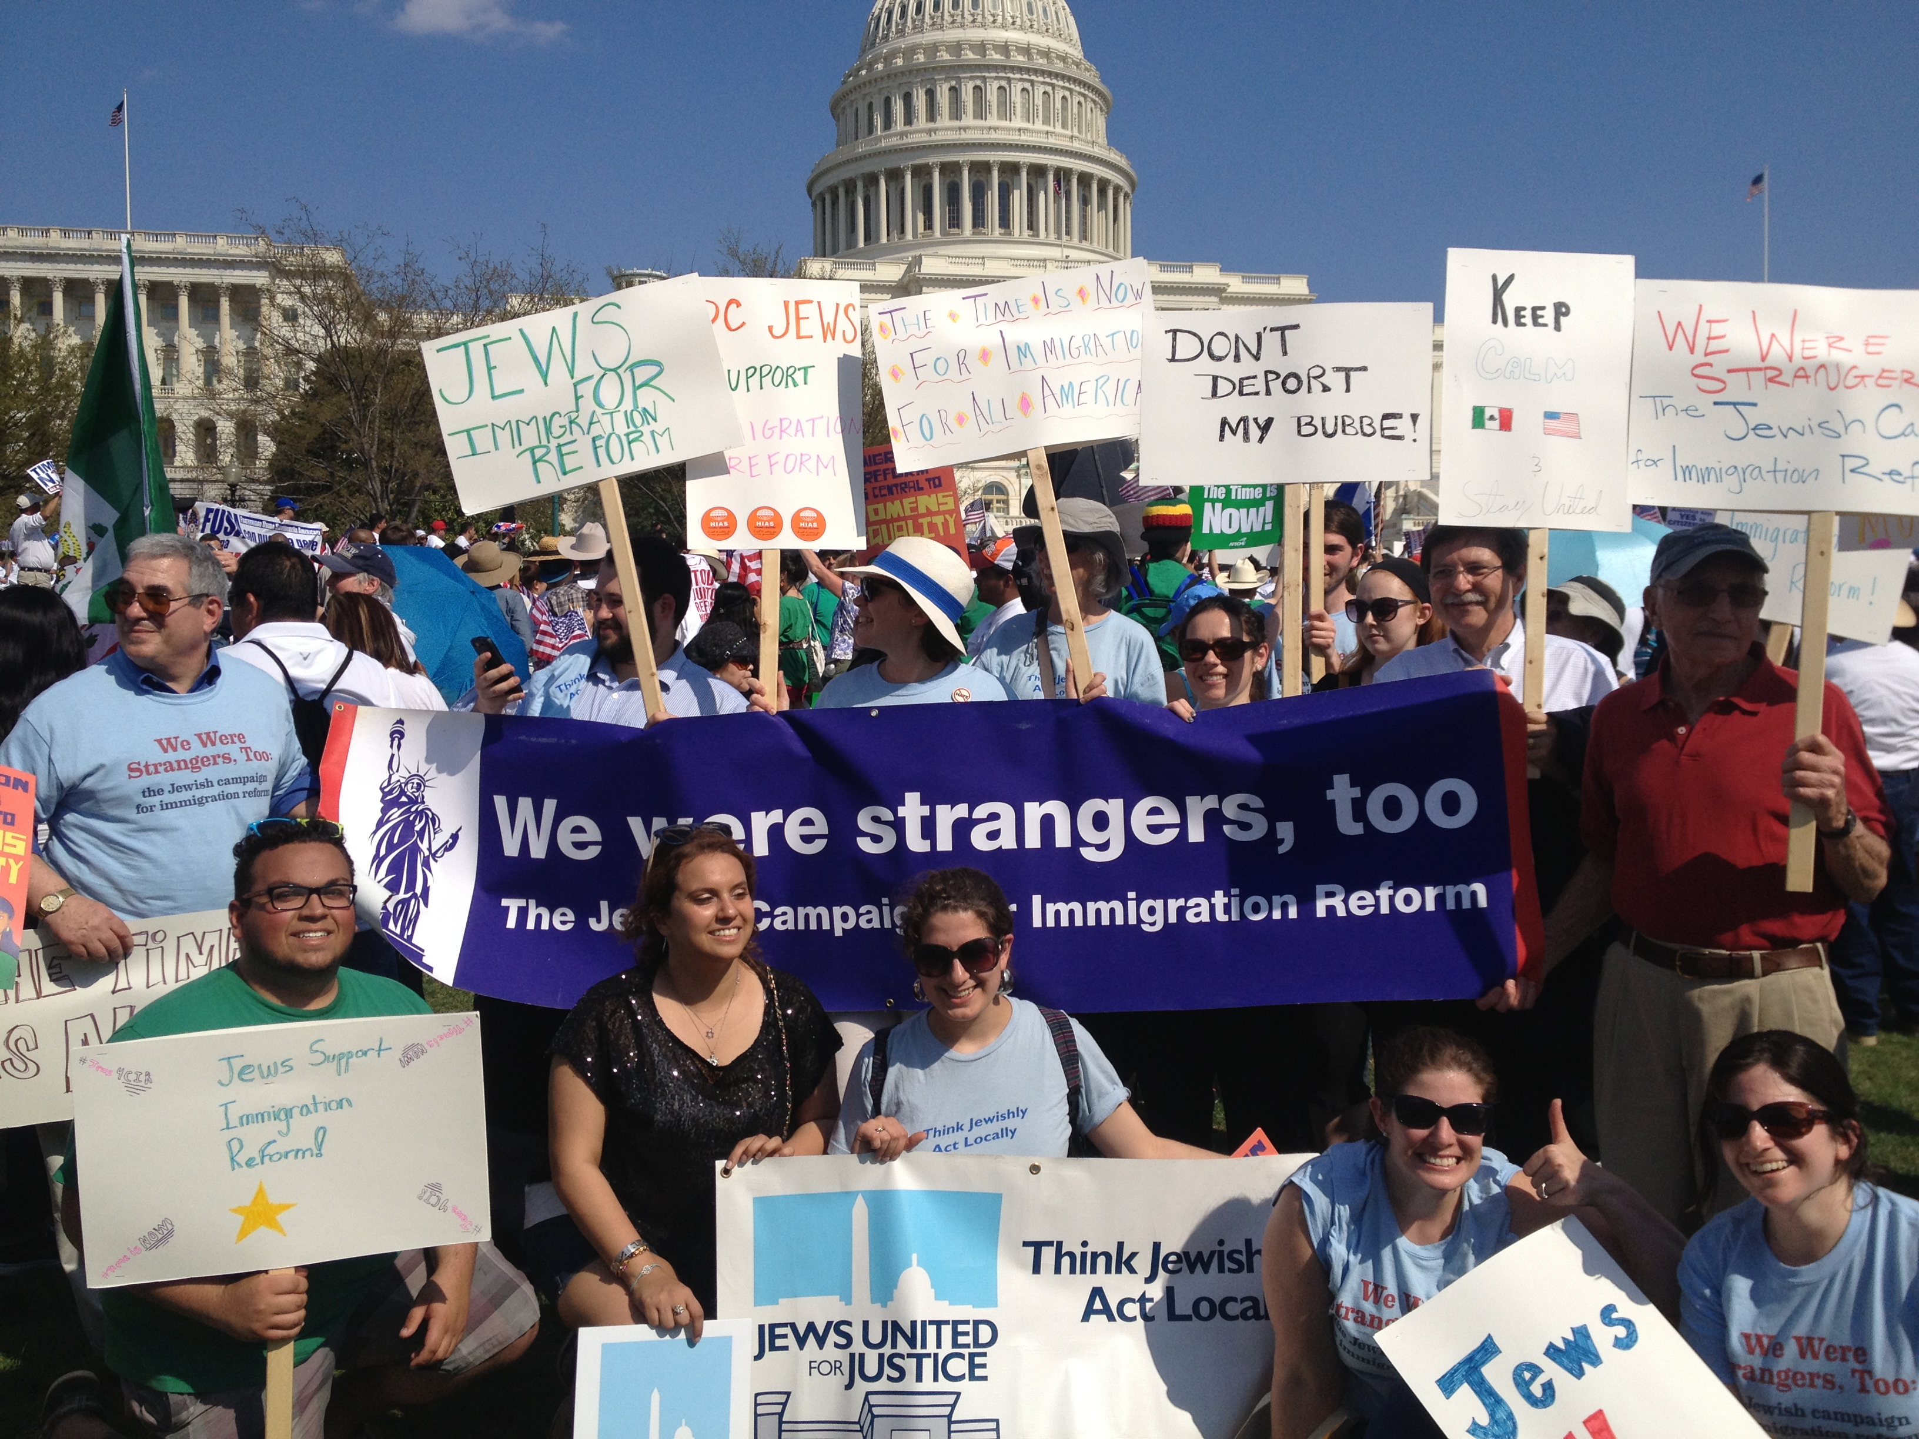
General Field Updates cont…
April 10th events

Slide 14

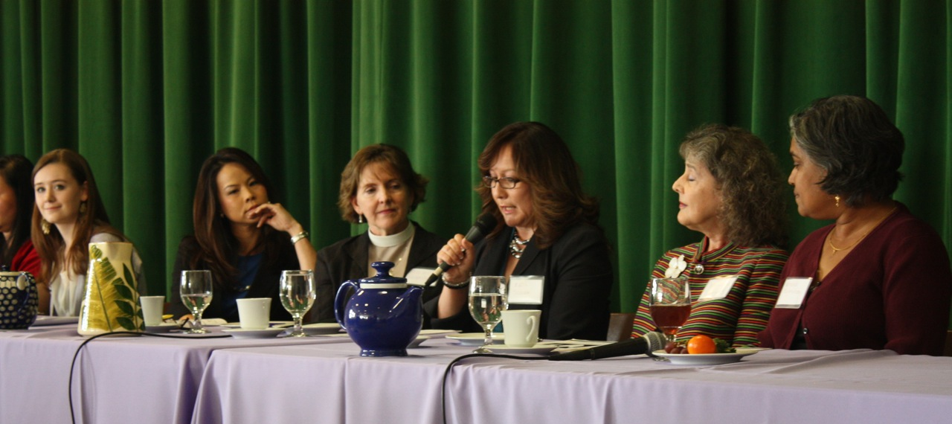
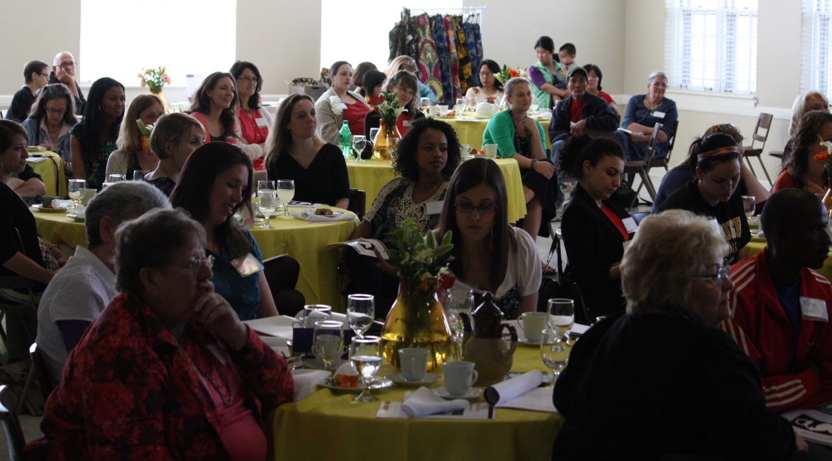
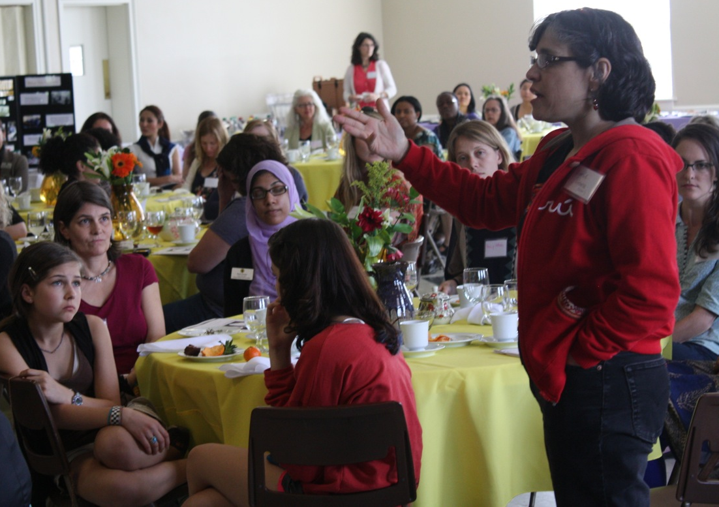
General Field Updates cont…
Ruth’s Journey event

Slide 15
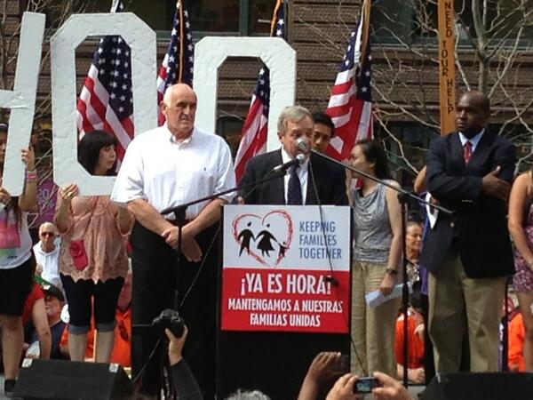
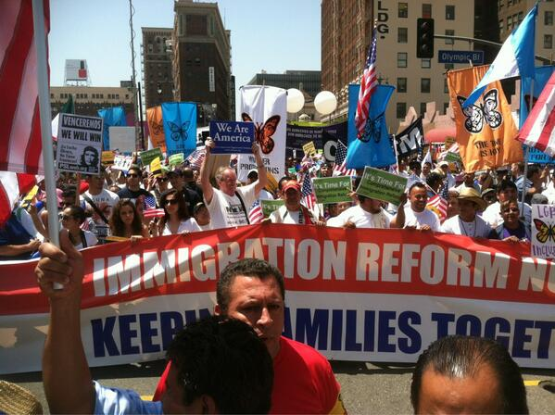
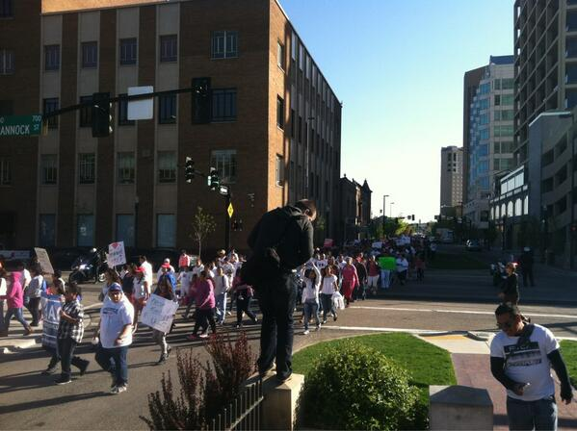
General Field Updates cont…
May Day events
Senator Durbin (D-IL) in Chicago
March for Citizenship in Los Angeles
Immigration
march in
Boise

Slide 16
Reminders
Tuesday Night is Family Night
In-District meeting toolkits
Register your faith actions
Share your immigration story
Host a family prayer vigil
Sign on to IIC principles for immigration reform
Spread the word about IIC monthly webinars

Slide 17

IIC Contacts by Organization
African American Ministers in Action: Leslie Malachi, lmalachi@pfaw.org
American Jewish Committee: Chelsea Hanson, hansonc@ajc.org
Bread for the World Institute: Andrew Wainer, awainer@bread.org
Church World Service: Jen Smyers, jsmyers@churchworldservice.org
Columban Center for Advocacy and Outreach: Chloe Schwabe, Cschwabe@columban.org
Disciples of Christ: Sharon Stanely, sstanley@dhm.disciples.org
Episcopal Church: Katie Conway, kconway@episcopalchurch.org
Franciscan Action Network: Marie Lucey, lucey@franciscanaction.org
Friends Committee on National Legislation: Ruth Flower, flower@fcnl.org
Hebrew Immigrant Aid Society: Liza Lieberman, liza.lieberman@hias.org
Interfaith Worker Justice: Michael Livingston, mlivingston@iwj.org
Irish Apostolate USA: Geri Garvey, administrator@usairish.org
Islamic Information Center: Hajar Hosseini, hosseini@islamicinformationcenter.org
Jesuit Refugee Service/USA, Shaina Aber, saber@jesuit.org
Jewish Council for Public Affairs: Elyssa Koidin, ekoidin@thejcpa.org
Lutheran Immigration and Refugee Service: Nora Skelly, nskelly@lirs.org
Mennonite Central Committee: Tammy Alexander, talexander@mcc.org
Muslim Public Affairs Council: Hoda Elshishtawy, hoda@mpac.org
Sisters of the Good Shepherd: Larry Couch, lclobbyist@gsadvocacy.org
NETWORK: Ashley Wilson, awilson@networklobby.org
Pax Christi: Scott Wright, scott@tassc.org
PICO: Heidi Thompson, hthompson@piconetwork.org
Presbyterian Church, USA: Melissa Davis, melissa.davis@pcusa.org
Sisters of Mercy of the Americas: Ryan Murphy, rmurphy@sistersofmercy.org
Sojourners: Ivone Guillen, iguillen@sojo.net
Union for Reform Judaism: Sarah Krinsky, askrinsky@rac.org
Unitarian Universalist Association: Jen Toth, JToth@uua.org
United Church of Christ: Rev. Mari Castellanos, castellm@ucc.org
United Methodist Church: Bill Mefford, bmefford@umc-gbcs.org
UNITED SIHKS: Harpreet Singh, harpreet.singh@unitedsikhs.org
U.S. Conference of Catholic Bishops: Kevin Appleby, kappleby@usccb.org
World Relief: Jenny Yang, jgyang@worldrelief.org

Slide 18
Upcoming Opportunity
The Jewish Social Justice Roundtable invites you to…
Webinar Training to prepare for In-District Lobby Visits
TOMORROW – Tuesday, May 7th
3-5pm EST
The Jewish Social Justice Roundtable invites you to a training, led by JOIN for Justice, the National Council of Jewish Women (NCJW) and the Jewish Council for Public Affairs (JCPA) to help prepare Jewish communities to meet with your members of Congress about immigration reform during the Memorial Day recess – May 27-31.
The training will cover:
how to share stories to legislators to show your community’s commitment to immigration reform,
how to demonstrate enough power to the legislators,
how to appeal to each individual legislators’ interests, and
how to run effective meetings with congressional offices.
Learn more at www.jewishsocialjustice.org and contact Abby with any questions at alevine@jewishsocialjustice.org.

