Slide 1
interfaithimmigration.org
Call and Webinar will begin on
Monday, December 7th at 4 p.m. ET
For audio, please dial 805-399-1000
and enter access code 104402
Audio Visual Link is at
http://join.me/faith4immigration

Slide 2
Agenda
Welcome and Introductions- Rev. Dr. Sharon Stanley-Rea, Director, Refugee & Immigration Ministries, Christian Church (Disciples of Christ)
Jen Smyers, Director of Policy and Advocacy, Church World Service - Immigration and Refugee Program
Terri Johnson, Executive Director, Center for New Community
Catherine Orsborn, Campaign Director, Shoulder to Shoulder

Slide 3
Syrian Refugees
November 13th Paris Attacks
Now-debunked rumors that one of the attackers was a Syrian refugee
31 Governors announced that their states will not accept Syrian refuges
Lawsuits in Indiana, Texas, others pending
House of Representatives passed HR 4038, which would grind the resettlement of Syrian and Iraqi refugees to a halt

Slide 4
The U.S. has the most secure refugee screening process in the world.
Biometric screenings
Medical tests
Interagency name & biography checks
Forensic document testing
In-person interviews with Department of Homeland Security (DHS) officials
DNA testing for family reunification
FBI
DHS
Department of State
Department of Defense
National Counterterrorism Center

Slide 5
Please take action TODAY: Call your Representative and Senators
The U.S. Senate and House of Representatives are working on a funding bill that they must pass by December 11th to keep the government open.
Tell Congress to OPPOSE any legislation or policy riders that would stop, pause or defund the resettlement of Syrian refugees.
1-866-961-4293
www.interfaithimmigration.org/issues/syrian-refugee-crisis/

Slide 6
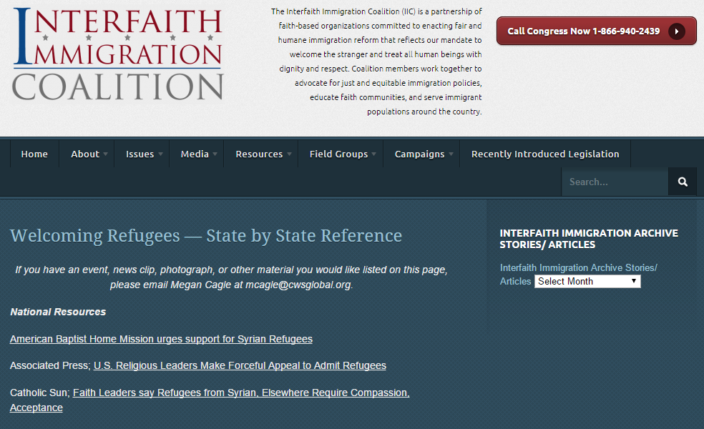
www.interfaithimmigration.org/welcoming-refugees-state-by-state-reference/

Slide 7
The Center for New Community tracks organized bigotry and equips grassroots movements to mobilize a powerful force for justice, fairness, and opportunity.

Slide 8
organized nativism
Ideological backbone of the modern day organized anti-immigrant movement & the Islamophobia movement.
Islamophobia movement
Anti-immigrant movement

Slide 9
The Islamophobia Movement
est. 1988
est. 1988
est. 2007
Lobby Arm
‘Think-Tank’
Grassroots

Slide 11
Anti-immigrant movement
Islamophobia movement
POLICY
TARGETING INCLUSION
MEDIA/
MESSAGING

Slide 12
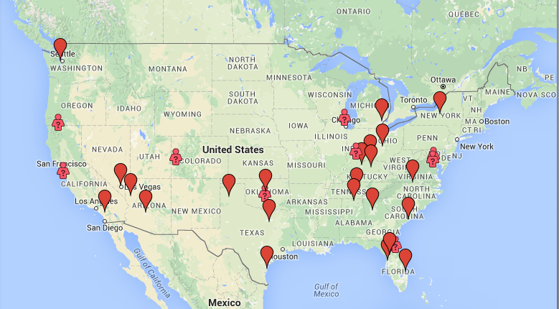
‘Global Rally for Humanity’

Slide 13
Define
the opposition
Know
the opposition
Control
the message
Motivate
action
Create echo chamber

Slide 14
31 national Religious denominations and faith-based organizations (list at www.shouldertoshouldercampaign.org/about/) = 44 Community Organizations
Focus on anti-Muslim sentiment in US as a challenge to all of our national, religious & moral values
National & local action, resourcing, and networking

Slide 15
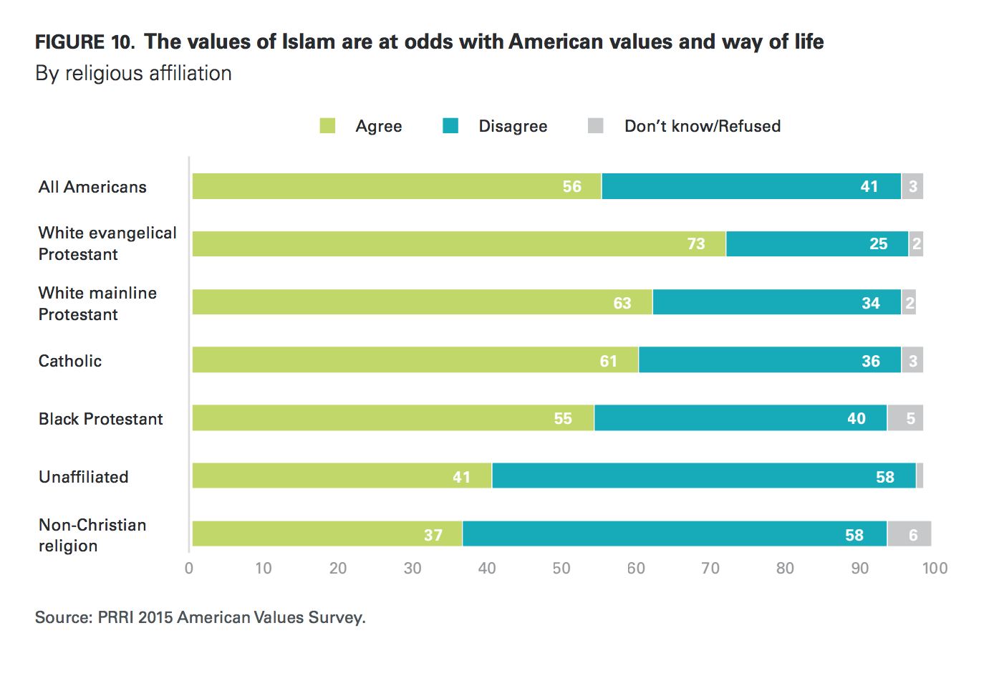

Slide 17
Faith Community Push-back on Anti-Muslim Rhetoric and Actions
Faith leader videos- digital/social campaign #LoveThyNeighbor #LiftMyLamp
Op-eds, clergy letters & meetings
Gather a few other faith leaders & meet with local Muslim community (through mosque or other networks)
Organizing local vigils, solidarity events, panels, town halls, community dialogues

Slide 18
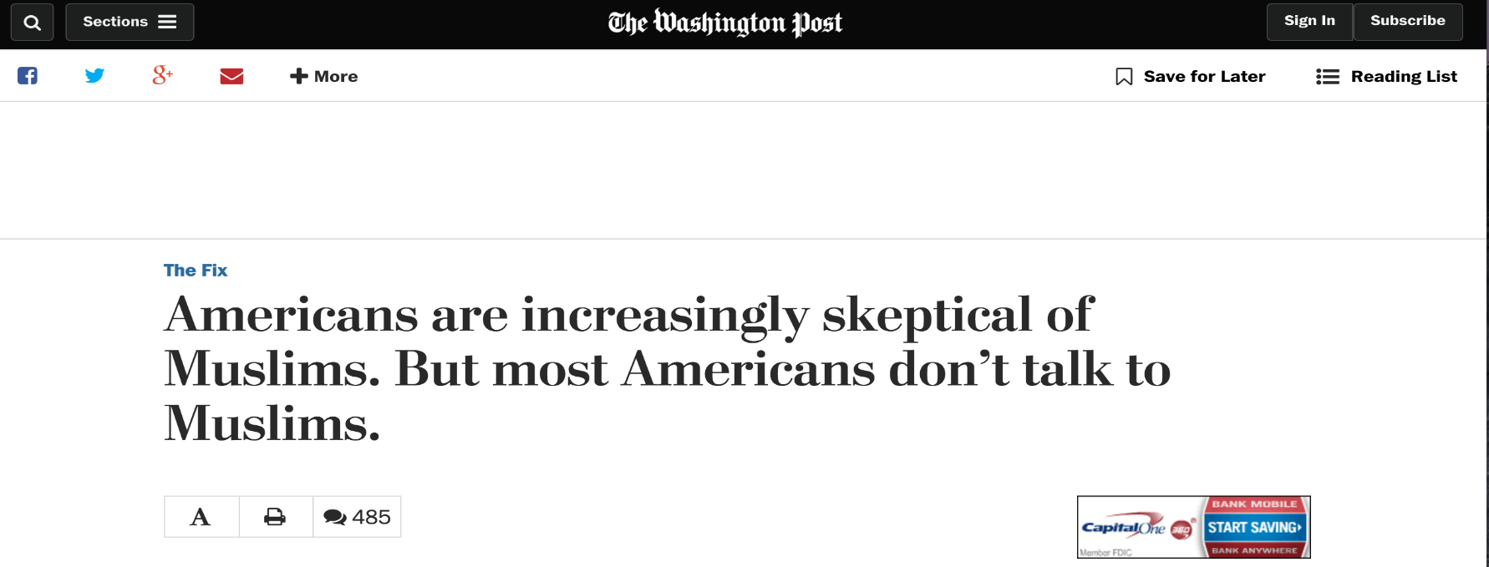
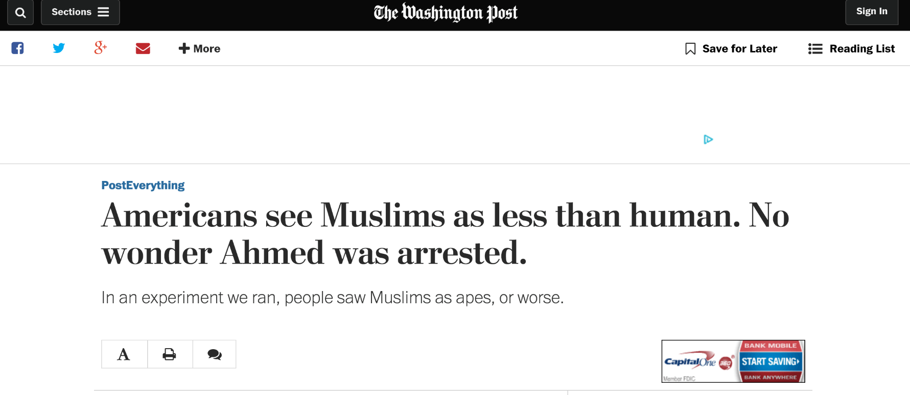

Slide 19
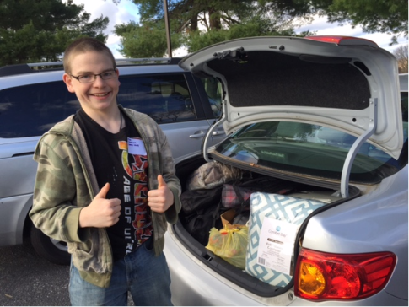
What Faith Communities Are Doing that Works
Welcome activities led by congregations include:
Highlighting Refugees’ stories in their weekly service and prayers
http://www.interfaithimmigration.org/2015/10/30/welcome-weekend-resources/
Hosting Interfaith prayer services, vigils and welcome dinners
http://www.interfaithimmigration.org/welcoming-dinners-resources-2/
Holding press conferences, forums and roundtables
Gathering Refugee Hospitality Kits

Slide 20
What Faith Communities Are Doing that Works
Writing Opinion Editorials and Letters to the Editor to encourage Congress to Listen to Faith Voices, Accept Syrian Refugees
Faith Leader Sign On Letters
Evangelical Leaders Letter:
http://evangelicalimmigrationtable.com/evangelical-immigration-table-syrian-refugee-letter/?utm
Multi-Faith Leaders Letter:
http://www.interfaithimmigration.org/wp-content/uploads/2015/09/Religious-Leader-Letter-Syrian-refugees_12.01.15.pdf?utm
1000 Rabbis Letter: http://www.hias.org/1000-rabbis-sign-letter-support-welcoming-refugees?utm_source=RIM%3A+Disciples+Refugee+Alert+-Dec.+7&utm_campaign=RIM+News+Jan.+2015&utm_medium=email
Petitions and petition deliveries

Slide 21
Greensboro, NC- Multicultural Thanksgiving Dinner and Press Conference
And other State by State Resources at:
http://www.interfaithimmigration.org/2015/12/03/welcoming-refugees-state-by-state-resources/

Slide 22
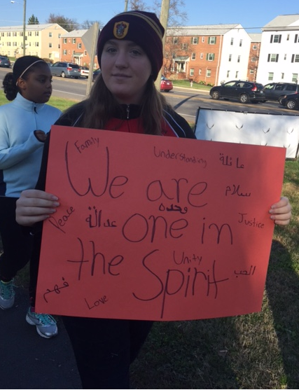
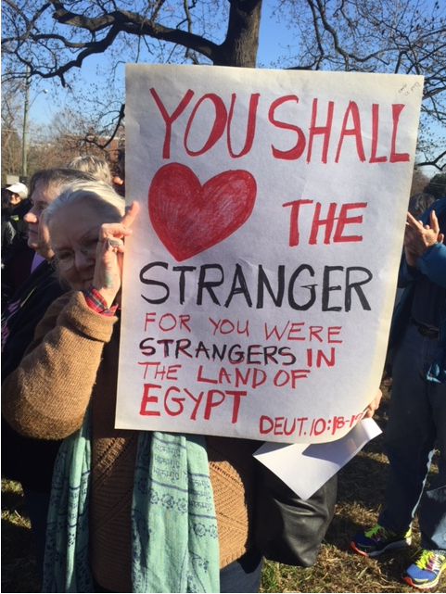
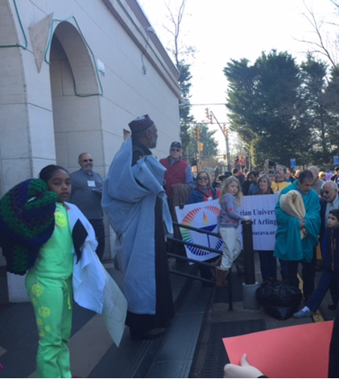
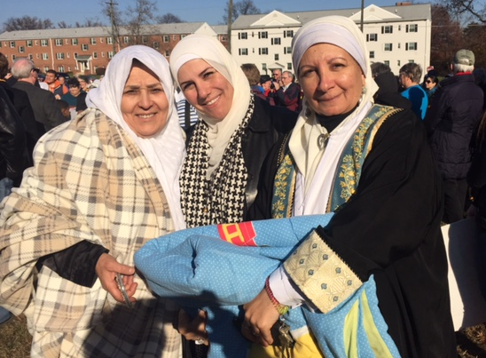
Falls Church, VA: Local church, mosque draw on interfaith alliance to aid refugees

Slide 23
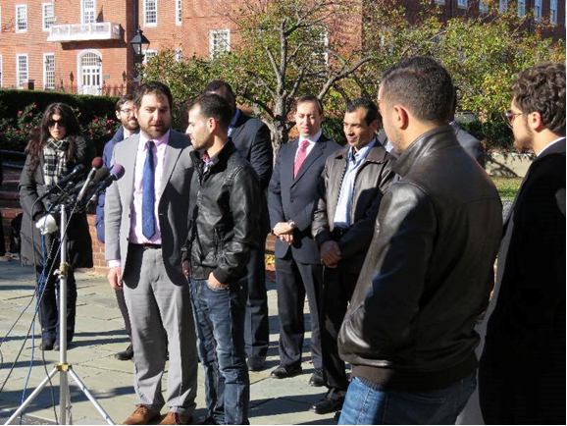
100 N.J. religious leaders to Christie: Follow your faith, accept Syrian refugees
Nearly 100 New Jersey religious leaders have signed a letter urging Gov. Chris Christie as "a man of faith" to reconsider his widely-publicized statements that the nation refuse all Syrian refugees, even "orphans under age 5."
PARTNER WITH SYRIAN LED ORGANIZATIONS
Such as the Syrian American Council’s new MEET A REFUGEE campaign, shown at left in a Press Conference in Maryland recently—just four days after arrival to the U.S.!!

Slide 24
Iowa Faith Leaders
From Hamburg Report- Local Newspaper
Faith groups react to efforts to keep Syrian refugees out of the U.S.
Leaders from Catholic, evangelical Christian and Jewish groups have spoken out against politicians' plans to reject Syrian refugees.
Clergy delivered Petition to Governor

Slide 25
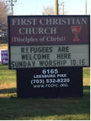
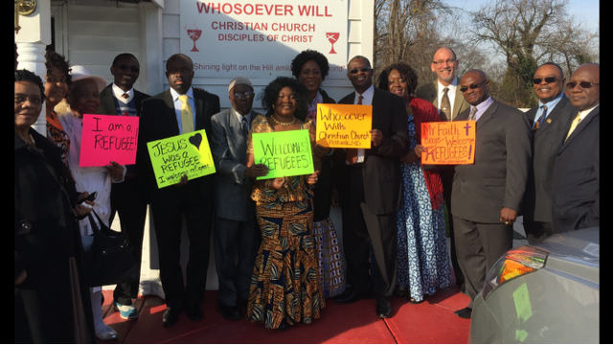
Discussion, Questions & Answers
What are you doing?
SEND your info. to: mcagle@cwsglobal.org or your faith organization staffer.

Slide 26
IIC Contacts by organization
African American Ministers in Action: Leslie Malachi, lmalachi@pfaw.org
American Baptist Home Mission Societies of the American Baptist Churches, USA:
Aundreia Alexander,
Aundreia.Alexander@abhms.org
American Friends Service Committee: Lia Lindsey, llindsey@afsc.org
American Jewish Committee: Chelsea Hanson, hansonc@ajc.org
Bread for the World Institute: Andrew Wainer, awainer@bread.org
Christian Church (Disciples of Christ): Sharon Stanley, sstanley@dhm.disciples.org
Christian Reformed Church Kris Van Engen, kvanengen@crcna.org
Church of the Brethren: Nate Hosler, nhosler@brethren.org
Church World Service: Jen Smyers, jsmyers@cwsglobal.org
Columban Center for Advocacy and Outreach: Chloe Schwabe,
cschwabe@columban.org
Conference of Major Superiors of Men: Eli McCarthy emccarthy@cmsm.org
Daughters of Charity: Mary Ellen Lacey, Maryellen.lacy@doc.org
Episcopal Church: Katie Conway, kconway@episcopalchurch.org
Franciscan Action Network: Marie Lucey, lucey@franciscanaction.org
Friends Committee on National Legislation: Ruth Flower, flower@fcnl.org
HIAS: Liza Lieberman, liza.lieberman@hias.org
Interfaith Worker Justice: Michael Livingston, mlivingston@iwj.org
Irish Apostolate USA: Geri Garvey, administrator@usairish.org
Islamic Information Center: (currently no contact available)
Jesuit Refugee Service/USA, Mary Small, msmall@jesuit.org
Jewish Council for Public Affairs: Jill Borak, jborak@thejcpa.org
Leadership Conference of Women Religious: Ann Scholz, SSND ascholz@lcwr.org
Lutheran Immigration and Refugee Service: Brittney Nystrom, Bnystrom@lirs.org
Maryknoll Office for Global Concerns: Judy Coode, jcoode@maryknoll.org
Mennonite Central Committee: Tammy Alexander, TammyAlexander@mcc.org
Muslim Public Affairs Council: Hoda Elshishtawy, hoda@mpac.org
Sisters of the Good Shepherd: Larry Couch, lclobbyist@gsadvocacy.org
National Council of Churches: Russell Meyer, rmeyer@floridachurches.org
National Council of Jewish Women: Madeline Shepherd, madeline@ncjwdc.org
NETWORK Lobby: Laura Peralta-Schulte LPeralta@networklobby.org
Pax Christi: Anne-Louise Nadeau, anadeau@paxchristiusa.org
PICO: Gordon Whitman, gwhitman@piconetwork.org
Presbyterian Church, USA: Teresa Waggener, Teresa.Waggener@pcusa.org
Sisters of Mercy of the Americas: Ryan Murphy, rmurphy@sistersofmercy.org
Sojourners: Ivone Guillen, iguillen@sojo.net
3P Human Security: Tom Brenneman, cooperativebydesign@gmail.com
T’ruah: The Rabbinic Call for Human Rights, Rabbi Rachel Kahn-Troster
rkahntroster@truah.org
Union for Reform Judaism: Jonathan Edelman jedelman@rac.org
Unitarian Universalist Association: Jen Toth, JToth@uua.org
United Church of Christ: Rev. Mari Castellanos, castellm@ucc.org
United Methodist Church: Bill Mefford, bmefford@umc-gbcs.org
UNITED SIKHS: Anisha Singh, anisha.singh@unitedsikhs.org
U.S. Conference of Catholic Bishops: Kevin Appleby, kappleby@usccb.org
U.S. Jesuit Conference, Shaina Aber, saber@jesuit.org
World Relief: Jenny Hwang jhwang@worldrelief.org

