Slide 1
interfaithimmigration.org
Responding to Humanitarian Crises: Syrian Refugees & Central American Refugees
Call and Webinar will begin on
Monday, October 19th at 4 p.m. ET
For audio, please dial 805-399-1000
and enter access code 104402
Audio Visual Link is at
http://join.me/faith4immigration

Slide 2
Agenda
Welcome and Introduction
Attack on Sanctuary Cities- Rev. Noel Andersen, National Grassroots Coordinator, Church World Service
Syrian Refugee Crisis, Jen Smyers, Director of Policy and Advocacy, Church World Service
Central American Humanitarian Crisis- Daniella Burgi-Palomino, Senior Associate Mexico, Migrant Rights, Border Issues, Latin America Working Group
Family Detention- Rev. Dr. Sharon Stanley-Rea, Director, Refugee & Immigration Ministries Christian Church (Disciples of Christ)

Slide 3
Attack on Sanctuary Cities
S. 2146 The Stop Sanctuary Policies and Protect Americans Act
Was stuck in Senate Judiciary Committee and passed on to Senate Floor for a scheduled vote on Tuesday October 20th at 2 PM ET, we’re advocating for the Democrats to filibuster S. 2146
This bill would block local jurisdictions from limiting their collaboration with U.S. Immigration and Customs Enforcement officials, punish sanctuary cities by defunding community policing programs and enacting otherwise discriminatory measures against immigrant communities. S. 2146 would also create a mandatory minimum sentence of five years in prison for anyone who has been deported and attempts to re-enter the United States.

Slide 4
NC HB 318
The “Protect North Carolina Workers Act,” also known as HB 318, is an attack on immigrant and low-income communities across the state of North Carolina.
If signed into law, HB 318 would place restrictions on the types of policies local governments can enact regarding law enforcement, it would limit the types of identification accepted across North Carolina, mandate more employers use E-Verify, and limit the Supplemental Nutritional Assistance Program for adults without children.

Slide 5
Stop HB 318/ Alto HB 318

Slide 6
State of Play: Syrian Refugees
4 million refugees, 8 million internally displaced
Lebanon, Turkey, Jordan hosting 3 million refugees
Germany pledged to welcome up to 1 million Syrians
Interesting fact: If the US were to welcome Syrians at the same rate proportionate to each country’s population, the US would welcome 3 million Syrian refugees
U.S. has only resettled 1,911 Syrian refugees
White House pledged to resettle 10,000 Syrians in Fiscal Year 2016, were already planning to resettle 5-8,000

Slide 7
State of Play: Syrian Refugees
Presidential Determination from 70,000 total refugees in 2015 to 85,000 in FY16 & 100,000 in FY17
Interesting fact: Where there’s a will, there’s a way. The US has shown leadership in resettling large numbers of refugees after conflict, including airlifting more than 200,000 Vietnamese refugees in 1980 alone.
Anti-immigrant / Anti-Muslim sentiment fueling Anti-Refugee proposals

Slide 8
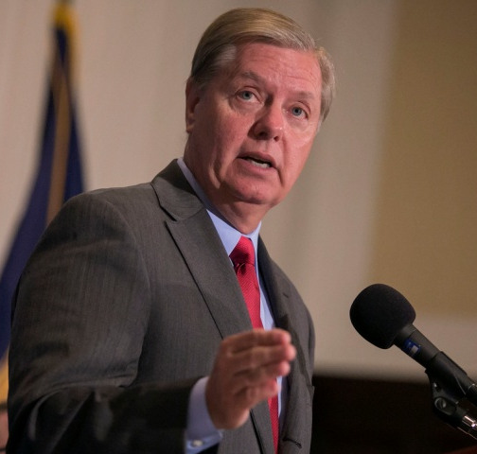
Syrian Refugee
Resettle 200,000 refugees in FY 2016, including 100,000 Syrians
Increase funding for UNHCR (UN Refugee Agency) to help Syrians abroad and refer more Syrians to resettlement
Increase Department of Homeland Security (DHS) capacity to interview and process Syrians
Parole in or designate a Priority 2 category Syrians with approved immigration petitions awaiting their priority dates (approximately 20,000)
Expand the P3 family reunification program so that Syrian Americans can apply for their family members - even if they themselves did not arrive in the US as refugees - and in addition to the usual immediate relative family members.
Increase resources for the governmental agencies that identify, help, process and resettle refugees
“we should take the Statue of Liberty and tear it down”
if the U.S. doesn’t accept more Syrian refugees
- Senator Lindsey Graham (R-SC)

Slide 9
Funding Update
Continuing Resolution (CR) to fund the government until December 11
They need to pass a longer-term funding bill for either CR or “omnibus” package of all federal agencies’ budgets
Opportunity for Administration to request more funds for State Department-PRM, the Refugee Corps within Department of Homeland Security (DHS), and Department of Health and Human Services-ORR
Senators Graham and Leahy introduced $1 billion supplemental to fund PRM for both overseas assistance and resettlement

Slide 10
Positive Refugee Legislation
Protecting Religious Minorities Persecuted by ISIS Act, H.R. 1568
Rep. Vargas (D-CA-51) and Rooney (R-FL-17)
Help Syrian and Iraqi refugees facing gender-based violence and religious and ethnic minorities; open more processing entities, increase staff, streamline security checks, expand video interviewing, improve accountability, transparency
Strengthening Refugee Resettlement Act, H.R. 2798 - Rep. Ellison (D-MN-5)
Admit refugees as LPRs; expand MG, R&P, case management; domestic resettlement emergency fund
Refugee Protection Act, S. 645 and H.R. 1375 (last year) - Sen. Leahy (D-VT) and Rep. Lofgren (D-CA-14)
Eliminate one-year filing deadline; protect refugee families; authority to designate groups for resettlement (“Lautenberg”)
Domestic Refugee Resettlement Reform & Modernization Act, S.1615 & H.R. 2839
Sen. Stabenow (D-MI) and Rep. Pascrell (D-NJ-9)
Elevates ORR within the HHS bureaucracy; allows formula state funding to include projected arrivals; helps with data collection & assistance to secondary migrants

Slide 11
Negative Proposals
Resettlement Accountability National Security Act, H.R. 3314 Rep. Babin (R-TX-36) – Houston area
Stop all U.S. resettlement until House and Senate pass resolution to re-establish the resettlement program; study on how many refugees use benefits, for how long, how many pay taxes during their first year in the U.S., various costs to programs
The Refugee Resettlement Oversight and Security Act, H.R. 3573 Rep. McCaul (TX-10)
Would place U.S. resettlement on hold, or stop it altogether, if Senate & House can’t pass joint resolution on refugee resettlement every year; would mandate that for resettlement from Iraq and Syria, religious minorities should be prioritized - aiming to prevent the resettlement of Muslim refugees.
Join religious leaders in opposing any proposal that would prevent Muslim refugees from accessing resettlement: https://docs.google.com/forms/d/1PNbNKO3TV1ZcoaKhhddNCV209kzGJvDs4yS11y5ODZw/viewform

Slide 12
Helpful Points
Refugees are the most scrutinized and vetted individuals to enter the US.
All refugees undergo thorough and rigorous security screenings.
Multiple systems are in place to maintain the security of the refugee resettlement program.
Communities, schools, congregations, and employers welcome refugees.
Refugees contribute to their new communities with their innovative skills, dedicated work, and inspiring perseverance.
Refugees provide substantial contributions to the workforce and to local economic development.
Many refugees are highly skilled and obtained high levels of education in their home countries.
Refugees are entrepreneurs, employers and employees, consumers, tax-payers, and engaged citizens.

Slide 13
Anti-Refugee Sentiment
Anti-Muslim protests last weekend
Recent hearings negatively conflated refugees with terrorism and public cost
Refugee Resettlement Watch, Act! For America, Numbers USA, and The Federal of Americans for Immigration Reform (FAIR) have joined with other hate groups to try to stop resettlement altogether
Resources on these groups: www.splcenter.org/hatewatch/2015/07/13/lauded-racist-groups-refugee-resettlement-watch-founder-ann-corcoran-moves-further-right

Slide 14
How can we help Syrians?
Call the White House: 202-456-1111
“The U.S. must show leadership in responding to the global refugee crisis, including in Syria. I urge President Obama to increase refugee resettlement to 200,000 this coming year, including 100,000 Syrian refugees.”
Meet with Senators & Representatives when they’re home Nov 9-13 & beyond. RCUSA Congressional Visit Toolkit!
Urge your community members to call their Members of Congress: 202-224-3121
Ask them to urge the administration to show leadership in response to the global refugee crisis by increasing resettlement numbers to 200,000, including100,000 Syrians, and to co-sponsor H.R. 1568, The Protecting Religious Minorities Persecuted by ISIS Act.

Slide 15
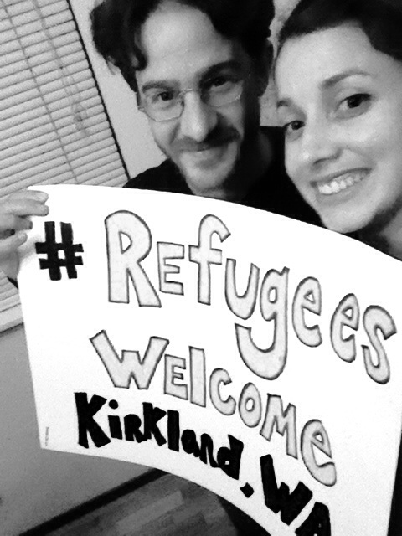
Have your voice heard!
Write an Opinion Editorial or Letter to the Editor of your local paper about the need to welcome Syrian refugees
Host events in your community to educate people about the crisis in Syria, the need for U.S. leadership, and how resettlement works
Share stories and photos of your community extending welcome to Syrian refugees on social media with #AmericaWelomes, #RefugeesWelcome, #WelcomeWorld

Slide 16
Resources
Toolkits for congressional visits:
Refugee Council USA: www.rcusa.org/uploads/pdfs/members/Local Congressional Visit Advocacy Toolkit_09.16.15.pdf
Interfaith Immigration Coalition: www.interfaithimmigration.org/wp-content/uploads/ 2013/01/IIC_NEIGHBOR_to_NEIGHBOR_Toolkit_01.pdf
Information on Senators, Representatives, Committees: www.senate.gov and www.house.gov
Sign up for advocacy alerts: bit.ly/refugeeadvocacy
Join quarterly National Refugee Advocacy Calls. Next Call: 12:00 PM EST Friday, November 7th.

Slide 17
Current “Asks”
For the Administration:
Increase refugee admissions to 200,000 per year, including 100,000 Syrians, and encourage other countries to also increase their welcome of Syrians
Reduce the length of time it takes to go through the U.S. admissions process
Request increased funding for refugee protection, processing & resettlement to meet needs
For Congress:
Urge the Administration to admit 100,000 Syrian refugees, in addition to 100,000 refugees from all over the world
Support H.R. 1568, The Protecting Religious Minorities Persecuted by ISIS Act, to help Syrian refugees
Affirm support for the life-saving, public-private partnership of refugee resettlement for people of all faiths. Meet with refugees in your states and districts.

Slide 18
Central American Refugee Crisis
Northern Triangle-El Salvador, Guatemala, Honduras
Serious governance challenges: corruption, impunity, inexistent citizen security
Highest homicide rates in the world
Mano dura responses to organized crime and gang violence
Internal displacement, nowhere to flee
Lack of government response & capacity

Slide 19
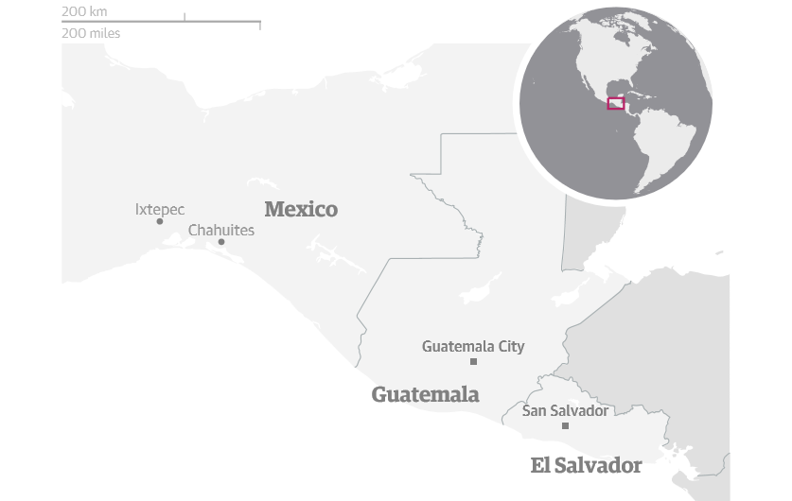
Conditions of Migrant Transit
70% increase in apprehensions of migrants under Mexico’s Southern Border Plan
Extortion, robbery, kidnapping, rape, trafficking
New dangerous, isolated routes to avoid checkpoints
Migrant shelters or “refugee camps”
Little to no access to asylum processing
92,889 deportations to CA, 12,511 children

Slide 20
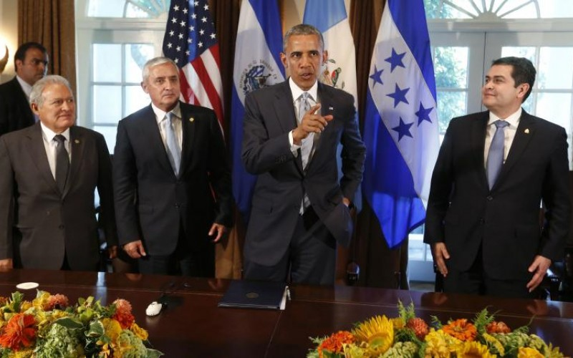
U.S. Policy Influences
U.S. outsourcing a refugee crisis, increased pressure for regional enforcement & public awareness campaigns
Assistance to Mexico via Merida Initiative
Central American Aid Package & Alliance for Prosperity Plan
House Appropriations Bill border security conditions
Inaccessible in-country refugee/parole processing program for minors (CAM)
U.S. increased family detention, reprioritizing court dockets

Slide 21
Sign our Petition!
bit.ly/MigrationPetition

Slide 22
Central American Family Detention
Homeland Security/The Administration
Judge Dolly Gee, 9th Circuit Court (L.A.)
Review of “the back and forth”:
July 24, Judge Gee, US Dist. Court, L.A., delivers 25 page ruling, finding administration’s behavior out of compliance with 18 year old Flores settlement
Early Aug., Admin. asked for a re-consideration of Gee’s ruling, said were trying to move families thru detention quickly.
August 21, Judge Gee refuses Admin’s request, delivers ruling that states Obama administration’s family detention policy in breach of Flores agreement, which said children cannot be held in unlicensed facilities, and limits amount of time families can be held. Gives Admin. till Oct. 23rd to comply.
Sept. 18, Secretary of Homeland Security said Dept. is complying with Gee’s August ruling, turning the 3 centers into short-term “processing centers.” Jeh ordered Justice Dept. to appeal the August ruling with 9th Circuit US Court of Appeals. . “We remain committed to reforming” but “we disagree with portions of the legal reasoning.”
Gov’t will ask court to throw out the ruling based on the Justice Dept’s original motions that Flores v. Meese doesn’t apply to children accompanied by their parents, or that changing circumstances & surge mean gov’t can’t safely comply. (Goodlatte urged this.)
What will happen by Oct. 23rd? Will Johnson fully comply, or ask SF 9th Circuit US Court of Appeals to ease the deadline?

Slide 23
Central American Refugees Family Detention Updates
In the midst of this crucial time, faith advocates have been offered to “gather” our campaigns and vigils around an image (at right) created by a Disciples clergy, Rev. Hector Hernandez.
If you’d like to use it, contact sstanley@dhm.disciples.org, send your logo, hashtag, and contact info. for your poster. Rev. Hernandez will make requested changes, with image credit.
*CONTINUE TO URGE FAITH COMMUNITIES TO CALL (202-456-1111) OR EMAIL (https://www.whitehouse.gov/contact/submit-questions-and-comments)
THE WHITE HOUSE BEFORE OCT. 23
TO COMMUNICATE OUR HOPE THAT THE ADMIN. WILL WITHDRAW FROM APPEALING JUDGE GEE’S URGING TO CLOSE THE DILLEY, KARNES CITY, AND BERKS CO.
FAMILY DETENTION CENTERS! Also tell them:
The use of family detention is an appalling stain on the United State’s human rights record, and is damaging to the well being of women and children who have already been deeply traumatized by violence in their own homeland.

Slide 24
Central American Refugees National Week to End Family Detention October 19-25 #EndFamilyDetention
Facebook event page for the national week of action: https://www.facebook.com/events/1636416669951075/
TUESDAY, OCT. 20:
National Call to End Family Detention, 11:00 am EST with front-line attorneys, released families & a Member of Congress to discuss. RSVP at: https://www.raicestexas.org/pages/action. Dial-in: (641) 715-3610 Code: 228132
Sponsored by RAICES, which provides free and low-cost legal services to underserved immigrants in Cent./So. TX.
Dallas, TX.-Vigil with community members & activists to end detention, 8101 N. Stemmons Freeway, 6:30 p.m.
WEDNESDAY, OCT. 21:
Minneapolis, MN.-Info. session with The Advocates for Human Rights, at Midtown Global Market, 920 E. Lake Street, Minn., kim@kimhunterlaw.com, 6:30-7:30 p.m.
THURSDAY, OCT. 22:
Washington, DC-March from US Dept. of Justice to the White House: 4:30-6:00 p.m.
San Antonio, TX.-Panel Discussion and Film Screening re: Realities of Family Detention, UTSA Downtown Campus, 501 W. Cesar Chavez Blvd., 6:30-8:30 p.m.
FRIDAY, OCT. 23:
New York City-Mothers Speak Out + Legal Services Clinic -Previously detained refugees, advocates, faith leaders gather at Columbia U. Law School, Jerome Greene Hall: 4:00-6:00 p.m.
Memphis, TN.-Candlelight Vigil, Nat’l Civil Rights Museum,450 Mulberry Street, sheila@sheilahahn.com: 6:00-8:00 p.m.
ALSO:
Cleveland: Jenna Peyton: jenna@attorneypeyton.com
Nashville: Andrew Free: andrew@immigrantcivilrights.com
For other events, people can reach out directly to mo@raicestexas.org

Slide 25
Central American Refugees Advocates Pushing Back on Licensing Efforts
Dilley and Karnes City Family Detention Centers
The state of Texas is considering licensing family detention centers as childcare facilities. In response:
More than 140 organizations and individuals to Texas state officials urging them to deny child care licenses to private prison companies operating family detention camps in South Texas.
Send your own message to Texas Gov. Greg Abbott and Texas Department of Family & Protective Services Commissioner John Specia, Jr.
Sign the petition against licensing family detention camps right now:
https://grassrootsleadership.ourpowerbase.net/civicrm/petition/sign?sid=22&reset=1

Slide 26
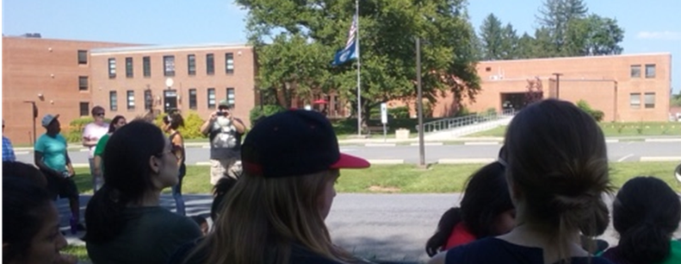
Central American Refugees Advocates Pushing Back on Licensing Efforts
Berks Co. Family Detention Center
Letter to Ted Dallas, the PA Secretary of the Department of Human Services, asking he immediately revoke the license of the Berks County Detention Center https://docs.google.com/forms/d/1-wzaADPmuJa8zhIicex65BvPaQePY_YX70SL4ylaY48/formResponse
If you have any questions about the Berks County Family Detention Center or this campaign you can contact Jasmine Rivera at jasmine@vamosjuntos.org or 480-628-4032.

Slide 27
Questions, Thoughts, Discussion

Slide 28
IIC Contacts by organization
African American Ministers in Action: Leslie Malachi, lmalachi@pfaw.org
American Baptist Home Mission Societies of the American Baptist Churches, USA:
Aundreia Alexander,
Aundreia.Alexander@abhms.org
American Friends Service Committee: Lia Lindsey, llindsey@afsc.org
American Jewish Committee: Chelsea Hanson, hansonc@ajc.org
Bread for the World Institute: Andrew Wainer, awainer@bread.org
Christian Church (Disciples of Christ): Sharon Stanley, sstanley@dhm.disciples.org
Christian Reformed Church Kris Van Engen, kvanengen@crcna.org
Church of the Brethren: Nate Hosler, nhosler@brethren.org
Church World Service: Jen Smyers, jsmyers@cwsglobal.org
Columban Center for Advocacy and Outreach: Chloe Schwabe,
cschwabe@columban.org
Conference of Major Superiors of Men: Eli McCarthy emccarthy@cmsm.org
Daughters of Charity: Mary Ellen Lacey, Maryellen.lacy@doc.org
Episcopal Church: Katie Conway, kconway@episcopalchurch.org
Franciscan Action Network: Marie Lucey, lucey@franciscanaction.org
Friends Committee on National Legislation: Ruth Flower, flower@fcnl.org
HIAS: Liza Lieberman, liza.lieberman@hias.org
Interfaith Worker Justice: Michael Livingston, mlivingston@iwj.org
Irish Apostolate USA: Geri Garvey, administrator@usairish.org
Islamic Information Center: (currently no contact available)
Jesuit Refugee Service/USA, Mary Small, msmall@jesuit.org
Jewish Council for Public Affairs: Jill Borak, jborak@thejcpa.org
Leadership Conference of Women Religious: Ann Scholz, SSND ascholz@lcwr.org
Lutheran Immigration and Refugee Service: Brittney Nystrom, Bnystrom@lirs.org
Maryknoll Office for Global Concerns: Judy Coode, jcoode@maryknoll.org
Mennonite Central Committee: Tammy Alexander, TammyAlexander@mcc.org
Muslim Public Affairs Council: Hoda Elshishtawy, hoda@mpac.org
Sisters of the Good Shepherd: Larry Couch, lclobbyist@gsadvocacy.org
National Council of Churches: Russell Meyer, rmeyer@floridachurches.org
National Council of Jewish Women: Madeline Shepherd, madeline@ncjwdc.org
NETWORK Lobby: Laura Peralta-Schulte LPeralta@networklobby.org
Pax Christi: Anne-Louise Nadeau, anadeau@paxchristiusa.org
PICO: Gordon Whitman, gwhitman@piconetwork.org
Presbyterian Church, USA: Teresa Waggener, Teresa.Waggener@pcusa.org
Sisters of Mercy of the Americas: Ryan Murphy, rmurphy@sistersofmercy.org
Sojourners: Ivone Guillen, iguillen@sojo.net
3P Human Security: Tom Brenneman, cooperativebydesign@gmail.com
T’ruah: The Rabbinic Call for Human Rights, Rabbi Rachel Kahn-Troster
rkahntroster@truah.org
Union for Reform Judaism: Jonathan Edelman jedelman@rac.org
Unitarian Universalist Association: Jen Toth, JToth@uua.org
United Church of Christ: Rev. Mari Castellanos, castellm@ucc.org
United Methodist Church: Bill Mefford, bmefford@umc-gbcs.org
UNITED SIKHS: Anisha Singh, anisha.singh@unitedsikhs.org
U.S. Conference of Catholic Bishops: Kevin Appleby, kappleby@usccb.org
U.S. Jesuit Conference, Shaina Aber, saber@jesuit.org
World Relief: Jenny Hwang jhwang@worldrelief.org

