Slide 1

Faith Community Response to an Unfaithful Budget
To join the webinar, you will go to http://join.me/faith4immigration and follow the directions for audio and visual. For audio only call, dial +1.202.602.1295, Access Code: 354-977-836#.

Slide 2
Agenda
Laura Peralta-Schulte, NETWORK Lobby
State of play
Jen Smyers, Church World Service
Refugees
Danny Cendejas, Detention Watch Network
Detention
Hannah Graf Evans, Friends Committee on National Legislation
ICE, CBP, Border
Central America
Next steps-- what can we do?

Slide 3
Budget 2018:
Upside Down Process In Turbulent Times
Laura Peralta-Schulte
NETWORK Catholic Social Justice Lobby

Slide 4
Republican Goals for 2018 Budget Cycle
Do a Republican Only Reconciliation Bill
BOTH a Funding Bill for 2018 & Tax Reform
Trump Administration Big Picture Frame for Funding:
Increase Money for Immigration Enforcement, Detention & “The Wall”
Cut Refugee Funding
Increase Money for Defense Spending
Cut Human Needs Funding
Republican Resistance to SOME Trump Priorities

Slide 5
Democratic Goals for 2018 Budget
Oppose Trump Budget
Opposition to Immigration Enforcement, Detention & “The Wall”
Opposition to Cuts in Refugee Funding
Maintain Full Funding for Domestic & International Human Needs
Use Process to Stop the Trump Administration’s Priorities

Slide 6
Timeline
House Republicans working now to pass a Budget Reconciliation bill before July 4th Recess
Senate Republicans:
Political Level: Working on passing a healthcare bill
Staff Level: Worker to develop funding priorities related to the 2018 Budget to push after House
2017 Budget Ends September 30th
Likely: Short-Term Continuing Resolution on Budget Until December

Slide 7
Politics Around Immigration/Refugee Spending
Leadership Likely to Make Decisions: Important to Reach
Final Budget May End Up Being Bi-Partisan: Leverage for Dems to Fight Funding
Weakness Within Dems: Senate Democrats Up In 2018 in States that Trump Won
Key: Find BIPARTISAN against BAD Immigration Spending and FOR Refugee Spending

Slide 8
Appropriations Update: Refugees
Jen Smyers
Church World Service

Slide 9
The President’s Budget Request: Refugee Resettlement
31% cut ($218 million) to refugee resettlement programs that support local communities and help refugees rebuild their lives
Eliminate refugee health promotion programs that help refugees and victims of torture, trafficking, and trauma receive needed services
Consolidate, and reduce overall, the Social Services and Targeted Assistance programs into one program, and it is unclear what impact this will have on these critical integration services
Change the formula that ORR uses to allocate funding to states, from the past 24 months to 12 months, which would negatively impact states given the recent reductions in refugee arrivals.
Require HHS to reimburse other agencies for land and building use for unaccompanied children, which would drastically reduce the ability for ORR to prioritize the safety and wellbeing of children.

Slide 10
The President’s Budget Request: Refugee International Assistance
Completely eliminate the Emergency Refugee and Migration Assistance (ERMA) account, which allows the U.S. government to respond to displacement crises that would otherwise result in regional instability.
10% cut to the Migration and Refugee Assistance (MRA) account, which provides humanitarian assistance to refugees overseas, supports refugee processing, and provides initial assistance to refugees during their first 30-90 days of arrival in the United States.
43% cut to the International Disaster Assistance (IDA) account, which provides emergency assistance to internally displaced persons and thus prevents them from having to become refugees.

Slide 11
The President’s Budget Request: Refugee Resettlement & Assistance
Plans to resettle only 50,000 refugees in FY18, the lowest refugee admissions goal in U.S. history.
Erroneously claims that by resettling fewer refugees we can help more people overseas, despite the fact that they also propose cuts to State Department accounts that assist internally displaced persons and refugees overseas.
By resettling refugees, the United States is able to convince other countries to keep their doors open to refugees and advance our foreign policy goals.
The initial investment in resettlement is paid back many times over as refugees quickly find jobs and contribute to their new communities.
Resettlement is a cost-effective form of humanitarian relief that is a lifeline to refugees who cannot return to their homes or rebuild their lives in a nearby country, many of whom end up serving as ambassadors of the American dream when it is finally safe for them to return.

Slide 12
Appropriations Update: Detention
Danny Cendejas
Detention Watch Network

Slide 13



Flashback
Supplemental funding request: Earlier this year, the current administration requested $3billion in additional funding for DHS
*already had $20billion
What ended up happening?
No more money for a new concrete wall
DHS received $1.4+ billion, most border technology ($772mil)
Funding for an average of 39, 324 detention beds for FY17
No increase in the number of ICE and CBP agents
An end to the arbitrary detention bed quota (34,000) - a costly and unprecedented policy that required the incarceration of 34,000 immigrants in detention at any given time

Slide 14


45’s Budget and Detention
51,370 people per day behind bars in detention (almost 500 million people over the course of the year)
79,000 people per day in surveillance programs such as electronic ankle monitors, up from 21,726 in 2014
A reorganization of detention systems
decrease or entirely remove standards for the majority of detention facilities
simultaneously decrease independent oversight of those same facilities
**Another key piece: Department of Justice

Slide 15









So what’s next?
Public education, organizing and tying to local work
Sign, share, call
Mobilize
*August recess

Slide 16
Contact
www.detentionwatchnetwork.org
Facebook.com/DetentionWatchNetwork
Twitter: @DetentionWatch
Danny Cendejas
Organizing Director
dcendejas@detentionwatchnetwork.org

Slide 17
Appropriations Update:
Deportation Force, Border Militarization, and Central America Funding
Hannah Graf Evans
Friends Committee on National Legislation (Quakers)

Slide 18
Deportation Force
Increase the deportation force by 1,500.
$300 million to hire 1,000 new Immigration and Customs Enforcement (ICE) officers to patrol U.S. communities
500 new Border Patrol agents, for a total of 20,258 agents
Congress has proposed lowering hiring standards to expedite the process
Congress must not fund any additional agents to expand the deportation force.
Notes:
. Watering down CBP hiring standards risks employing CBP officers and agents who could jeopardize national security and community safety; there is a history of agents who have been prone to corruption, collusion with international drug trafficking organizations, or abuses of power through excessive force or sexual assault.

Slide 19
Border Militarization
$2.6 billion down-payment for the wall and increased militarization of border communities including sensors, towers, and drones.
Barriers and militarization along the southern border have proven ineffective, costly, harmful for the environment, and dangerous for human and civil rights.
Congress should not fund further militarization of our border communities.

Slide 20
Central America Funding
Deep cuts to foreign assistance. 39% cut total, 42% cut in economic assistance. All Development Assistance cut for Central America.
Military, Law Enforcement, and Narcotics are also cut significantly in the request, but could be included in Defense spending.
US foreign assistance should prioritize addressing the root causes of migration by reducing poverty and preventing violence through community based approaches.
Efforts that strengthen governance and the rule of law, and that increase citizen security, including protection systems for children and other vulnerable populations, are also essential to ensure the right not to have to migrate.
More questions? Contact: Kristen Lionetti, klionetti@jesuits.org
Notes:
General: Focus on transnational criminal organizations, strengthening border security, combatting corruption. Pushing Mexico to do more on southern border (ex: upcoming mid-June meeting)
(Economic Support tends to focus on political goals vs. development assistance)
Defense Spending - OCO

Slide 21
Opportunities for Advocacy Around the Budget
Hannah Graf Evans
Friends Committee on National Legislation (Quakers)

Slide 22
Congress holds the “purse strings”
President Trump cannot fulfill his agenda without congressional blessing.
Building relationships between people of faith, impacted communities, and public officials is the most powerful agent of change.
Our role is to make it clear that Congress cannot undercut immigrants and refugees in their spending bills.

Slide 23
Let the faithful voice ring out in the face of injustice!
Outward communications:
Press conferences
Vigils and public witness
Writing letters to the editor or op-eds
Direct communication:
In-district visits with members of Congress or staff
Attending town halls
Calling and emailing offices

Slide 24
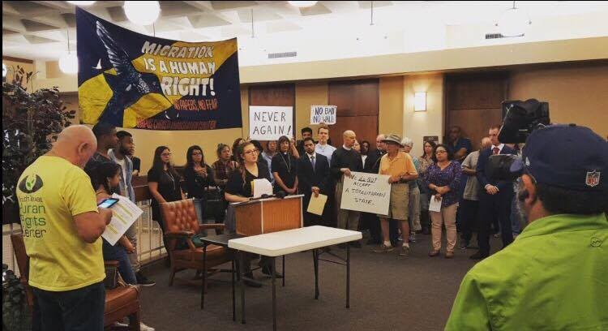
Press Conference Outside a Congressional Office

Slide 25
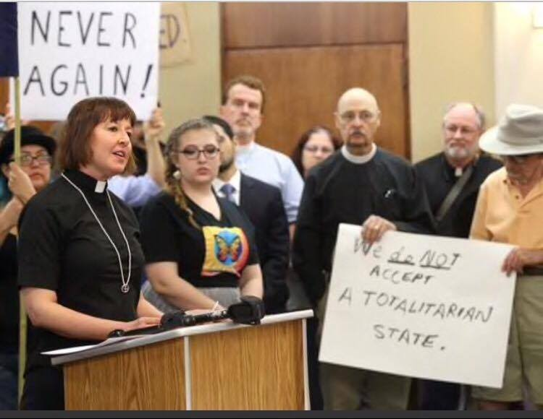
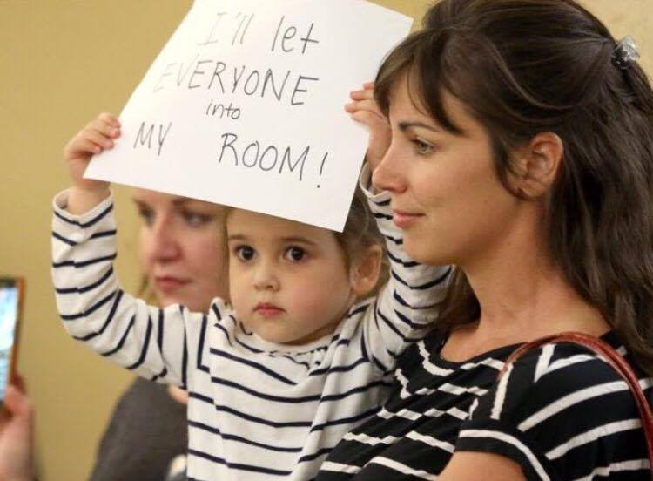
Corpus Christi Immigration Coalition
Held press conference outside of office to emphasize the role of elected officials in countering the Executive Orders in January
Included a diverse set of speakers, age, religious affiliation and gave remarks in both English and Spanish
Staffer came out of the office and inquired as to who they were, what the purpose was, what local media outlets were there
They used the opportunity to request a member level meeting

Slide 26
Write for a newspaper!
Members of Congress track when they are mentioned in media, include their names and an “ask”
If you host a vigil or public witness event and no one covers it – write about it!
Send letters to the editor and op-eds to the office of your member of Congress even if they don’t get published

Slide 27
Letter to the Editor Framework
Respond to Recent Reports: Find a news article or story that relates to the issue. Make sure you’re responding to a recent story or topic – no more than a few days old.
Ask for Action: Make a specific ask to specific policymakers. Mentioning your members of Congress by name is an important way to make sure they see it.
Find the Facts: Illustrate your argument with one or two facts. Statistics can be helpful in moderation, but too many statistics can be confusing.
Tie It Together: Bring in your personal connection or moral approach to the issue. State your connections to the community as they’re relevant to the points you’re making.
Submit your Letters to the Editor to newspapers here: http://act.fcnl.org/lte/lte/

Slide 28
Sample Text for a Letter to the Editor
President Trump’s budget request does not represent the welcoming community that I know City, State to be.
As a person of faith, I want my tax dollars to reflect a shared faithful call to love my neighbor, welcome the stranger, and care for the sojourner. We should not close the door on those in need by slashing refugee resettlement and assistance funding or spend billions of dollars on endless immigration enforcement that tears families apart through unjust detention and deportation.
I hope that I count on Senators X and X and Representative X to oppose funding an expansion of immigration enforcement and detention in 2018 and robustly fund refugee resettlement in the U.S. and assistance abroad.

Slide 29
Set up a constituent lobby visit!
Congress is on recess from July 3-7. They should hear from you while they are home.
Go to http://interfaithimmigration.org/neighbor to find our toolkit and start brainstorming with your team.

Slide 30
How to have an effective conversation
Respect
Thanks
Finding common ground
Facts
Personal stories
Goal is to build a relationship for future efforts, highlight the human impact of policy decisions

Slide 31
How to prepare for a visit
Do your research! Know the representative’s position on the issue, voting history, biographical information, key issues, etc.
Find a thank-you
Find a team of diverse representatives
Schedule the meeting well in advance
Practice ahead of time

Slide 32
Constituent Lobby Visit Road Map
Introduction
Thank you
Share personal stories, impact on district/state
Repeat the “Ask”
Can we count on you to oppose funding an expansion of immigration enforcement and detention in FY18 and robustly fund refugee resettlement in the U.S. and assistance abroad?
Listen for their response and follow-up questions
Thank you, repeat “ask”
Follow up!
Notes:
How can your conversation be most effective?
Respect
Thanks
Finding common ground
Facts
Personal stories

Slide 33
After your visit
Debrief
Follow up with the member and their office!
Call their Washington D.C. office
Let us know how your visit went so that our staff can help you follow up:
Find the form at http://interfaithimmigration.org/neighbor

Slide 34
Show up to a Town Hall
Use the same framework that you would on a constituent lobby visit:
Introduction, connection to community
Thank you
Frame the question, share how it affects the district/state
Ask: Can we count on you to oppose funding an expansion of immigration enforcement and detention and robustly fund refugee resettlement in the U.S. and assistance abroad?
Find town halls at: http://www.townhallproject.com

Slide 35
Calling and Emailing Offices
Action Alerts from the Interfaith_Immigration@yahoogroups.com listserv have background, numbers, and scripts
June 12-16 Call in Week to Stand With Refugees: StandwithRefugees.us or text “STAND” to 313131 for reminders
Write your own message directly to your members of Congress: http://cqrcengage.com/fcnl/action

Slide 36
Stay engaged all through the summer for a budget that reflects your values!
Questions? Feel free to contact me:
Hannah Evans hannah@fcnl.org
Friends Committee on National Legislation

Slide 37
IIC Contacts by Organization
African American Ministers in Action: Leslie Malachi, lmalachi@pfaw.org
American Baptist Home Mission Societies of the American Baptist Churches, USA: Brenda Halliburton, brenda.halliburton@abhms.org
American Friends Service Committee: Kathryn Johnson, kjohnson@afsc.org
American Jewish Committee: Richard Foltin, foltinr@ajc.org
Bread for the World Institute: Marco Grimaldo, mgrimaldo@bread.org
Christian Church (Disciples of Christ): Sharon Stanley, sstanley@dhm.disciples.org
Christian Community Development Association: Michelle Warren, michelle@ccda.org
Christian Reformed Church: Kelsey Herbert, kherbert@crcna.org
Church of the Brethren: Nate Hosler, nhosler@brethren.org
Church World Service: Jen Smyers, jsmyers@cwsglobal.org
CLINIC| Catholic Legal Immigration Network, Inc: Michelle Sardone, msardone@cliniclegal.org
Columban Center for Advocacy and Outreach: Rebecca Eastwood, reastwood@columban.org
Conference of Major Superiors of Men: Eli McCarthy, emccarthy@cmsm.org
Daughters of Charity: Mary Ellen Lacy, Maryellen.lacy@doc.org
Episcopal Church: Lacy Broemel, lbroemel@episcopalchurch.org
Evangelical Lutheran Church in America: Alaide Vilchis Ibarra, Alaide.Ibarra@elca.org
Franciscan Action Network: Marie Lucey, lucey@franciscanaction.org
Friends Committee on National Legislation: Hannah Evans, hannah@fcnl.org
HIAS: Liza Lieberman, liza.lieberman@hias.org
Ignatian Solidarity Network: Christopher Kerr, ckerr@ignatiansolidarity.net
Interfaith Worker Justice: Laura Barrett lbarrett@iwj.org
Irish Apostolate USA: Marie Prefontaine, coordinator@usairish.org
Jesuit Conference of Canada and the U.S.: Kristen Lionetti, klionetti@jesuits.org
Jesuit Refugee Service/USA: Guilia McPherson, gmchperson@jesuits.org
Jewish Council for Public Affairs: no contact currently
Leadership Conference of Women Religious: Ann Scholz, SSND ascholz@lcwr.org
Lutheran Immigration and Refugee Service: McKayla Eskilson, meskilson@lirs.org
Maryknoll Office for Global Concerns: Judy Coode, jcoode@maryknoll.org
Mennonite Central Committee U.S.: Tammy Alexander, TammyAlexander@mcc.org
Muslim Public Affairs Council: Hoda Elshishtawy, hoda@mpac.org
Sisters of the Good Shepherd: Larry Couch, lclobbyist@gsadvocacy.org
National Council of Churches: Russell Meyer, rmeyer@floridachurches.org
National Council of Jewish Women: Faith Fried, Faith@ncjwdc.org
National Justice for Our Neighbors: Rob Rutland-Brown, rob@njfon.org
NETWORK Lobby for Catholic Social Justice: Laura Peralta-Schulte, LPeralta@networklobby.org
Pax Christi: Anne-Louise Nadeau, anadeau@paxchristiusa.org
PICO: Rich Morales rmorales@piconetwork.org
Presbyterian Church, USA: Teresa Waggener, Teresa.Waggener@pcusa.org
Scalibrinian International Migration Network/Center for Migration Studies: Kevin Appleby; kappleby@cmsny.org
Sisters of Mercy of the Americas: Jean Stokan, jstokan@sistersofmercy.org
Sojourners: Michael Mershon, mmershon@sojo.net
T’ruah: The Rabbinic Call for Human Rights: Rabbi Rachel Kahn-Troster, rkahntroster@truah.org
Union for Reform Judaism: Shelby Friedman, sefriedman@rac.org
Unitarian Universalist Association of Congregations: Susan Leslie, SLeslie@uua.org
Unitarian Universalist Service Committee: Hannah Hafter, hhafter@uusc.org
United Church of Christ, Justice and Witness Ministries: Rev. Jason Carson Wilson, wilsonj@ucc.org
United Methodist Church: Jeania Ree Moore, jmoore@umcjustice.org
UNITED SIKHS: Anisha Singh, anisha.singh@unitedsikhs.org
U.S. Conference of Catholic Bishops: Todd Scribner, tscribner@usccb.org
World Relief: Jenny Hwang, jhwang@worldrelief.org

