Slide 1
Recent Raids and Cuts to Refugees:
Faith Community Response
To join the webinar, you will go to http://join.me/faith4immigration and follow the directions for audio and visual. For audio only call, dial +1.202.602.1295, Access Code: 354-977-836#.

Slide 2
Welcome to all!
Rev. Dr. Sharon Stanley-Rea
Refugee & Immigration Ministries
Christian Church (Disciples of Christ)

Slide 3
Agenda
Overview and impact of DHS memos
Overview and impact of Executive Order on refugees and Muslims
Sanctuary Movement and Rapids Response
Know Your Rights
Local Advocacy
Q&A

Slide 4
DHS Memos on Executive Orders on Border and Interior Enforcement
Jen Smyers, Church World Service
Target ALL undocumented immigrants
Perpetuate false narratives about immigrants
Further militarize border communities
Turn away asylum seekers and punish parents who help children seek safety
Force local police to serve as immigration agents

Slide 5
Target ALL Undocumented Immigrants & Perpetuate False Narratives about Immigrants
Immigration and Customs Enforcement (ICE) terminates all prosecutorial discretion guidelines
DACA recipient in Washington State
Mother in Arizona
Methodist lay leader in Kansas
Domestic violence survivor in Texas
Men leaving a hypothermia shelter at Rising Hope Mission Church in Virginia
DHS established a new Victims of Immigration Crime Engagement (VOICE) Office

Slide 6
Further Militarizes Border Communities
Mandates the hiring of 5,000 additional Customs and Border Patrol agents and 10,000 additional ICE agents
Directs CBP to develop a plan and begin construction of border wall, requiring “complete operational control of the border”
100% control is an unattainable goal
DHS has estimated that it will cost $21 billion to build an additional 1,250 miles of fencing and other physical barriers by 2020, not including maintenance costs.

Slide 7
Turns Away Asylum Seekers and Punishes Parents who Help Children Seek Safety
Expansion of mandatory detention
Will erode the rights and wellbeing of thousands of people
ICE’s current capacity of 34,000 detention beds costs taxpayers more than $2 billion each year.
Significantly expands expedited removal
Fast tracking deportations for individuals, including asylum seekers with no due process
The memo suggests that expedited removal may be used for anyone who has been in the U.S. for less than two years.
Authorizes DHS to return individuals picked up by border patrol to Mexico to await their asylum hearing
Women, children, and other vulnerable individuals will be at risk of violence in Mexico
Increased likelihood of deportation without due process by the Mexican authorities.

Slide 8
Asylum seekers continued..
The memo calls for restricting the interpretation of “unaccompanied alien child,”
Many children will be left without protections such as placement in a care facility suitable to their needs, and access to social services
Children who do not meet the definition will not have the opportunity to appear before an immigration judge before being ordered removed
The memo directs DHS to deport and criminally charge anyone who “directly or indirectly” facilitates the smuggling or trafficking of children into the U.S.,
This includes sending money to help children make the journey
The memo states that undocumented family members hire smugglers, and by doing so “conspire to violate our immigration laws.”

Slide 9
Forces Local Police to Serve as Immigration Agents
Memo expands the 287(g) agreements authorizing local police to arrest undocumented people
ICE will begin regularly reporting on local law enforcement agencies who release immigrants from custody
This memo reinstates the Secure Communities (S-Comm) Program, wherein local police are asked to hold immigrants who are suspected to be undocumented
In 2014, S-Comm was terminated after it became mired in controversy and litigation due to constitutional concerns regarding ICE detainers and racial profiling
More than 350 localities have limited their relationship with immigration enforcement, including detainer requests, to better protect their communities and ensure their law enforcement officials comply with the Constitution.

Slide 10
Rewritten Executive Order
Effective date: March 16th
Suspends all people from Syria, Iran, Yemen, Libya, Somalia, Sudan for 90 days (note: Iraq is not included on the list in this rewritten version)
Suspend all refugee resettlement for 120 days
Reduce FY17 refugee admissions from 110,000 to 50,000
Lay groundwork for more state / local authority over resettlement
Review and additional vetting procedures
Current visa holders, green card holders, Special Immigrant Visa recipients and dual nationals are exempt
No explicit language indefinite suspending Syrian resettlement*
No explicit language prioritizing religious minorities*
The courts, Congress, and the public must ensure that the administration does not move forward with these policies through other means.

Slide 11
Still a Refugee Ban, Still a Muslim Ban
By the administration’s own admission, this rewritten version will have the same impact while seeking to avoid court challenges.
“Pausing” resettlement for 4 months will grind processing to a halt
Each step of the screening process is time sensitive, leaving refugees only a 2-month window when all checks are complete and valid. This will cause a domino effect of expiring validity periods, forcing refugees who are already approved to repeat fingerprinting and medicals tests, which could take years, all while their lives are in danger.
By reducing refugee admissions from 110,000 to 50,000, we are turning our backs on refugees who we promised to protect, who have already been approved, and for whom resettlement is their last hope to rebuild their lives.
Even though Iraq was removed from the barred countries, and Special Immigrant Visa (SIV) holders are exempt, more than 50,000 Iraqis who are persecuted due to their work with the United States will still be impacted by the drastic reduction in resettlement and 120 suspension.

Slide 12
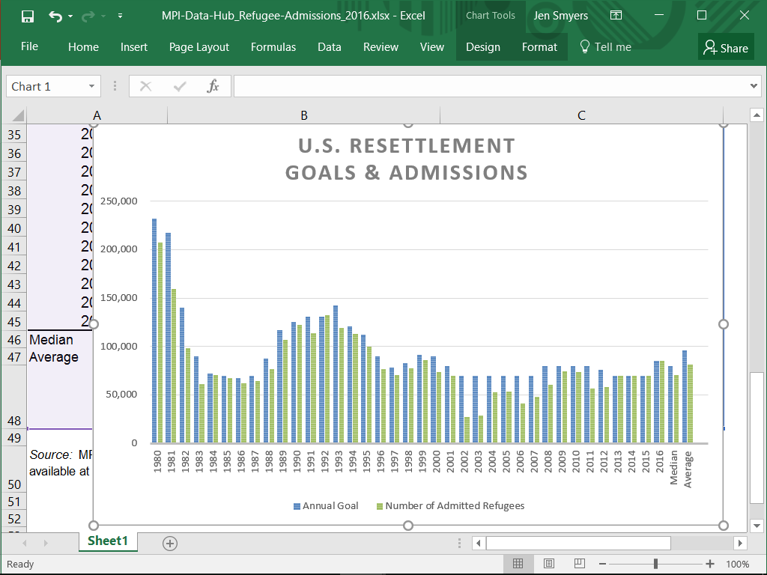

Slide 13
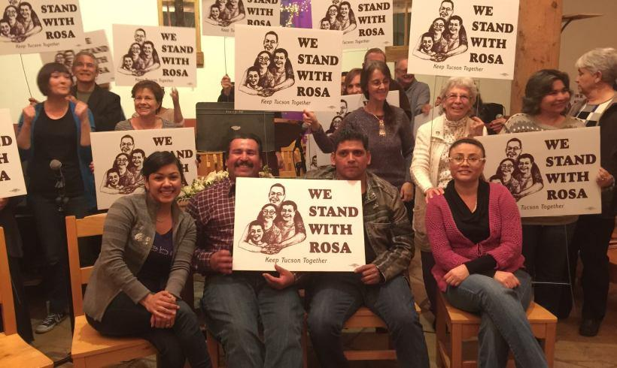
SANCTUARY MOVEMENT
Noel Andersen, Church World Service

Slide 14
How to Become a Sanctuary Congregation
Sanctuary is a way to be in solidarity with the undocumented community by creating safe space for the prophetic voice of immigrant leaders to be lifted up as we together confront unjust laws
A church that declares itself a Sanctuary congregation is one willing to engage on a spectrum of solidarity actions including welcoming undocumented people, advocating to help stop deportations, assisting with legal clinics and physically shelter an immigrant in danger of immediate deportation

Slide 15
From 400-800 Sanctuary congregations
Each congregation has the opportunity to go through a discernment process of education and dialogue to decide their role in the movement.
The Sanctuary Movement network that we are a part of focuses on offering public sanctuary in congregations and solidarity to those organizing networks of deportation defense among vulnerable communities.
There is an added layer of symbolic protection for someone facing a deportation to find shelter in a place of worship, which is why we’re focusing on providing Sanctuary in our congregations at this time.

Slide 16
Sanctuary Goals
As the faith community, we are called to accompany our community members, congregants and neighbors facing deportation through joining the Sanctuary Movement and working to stop deportations case-by-case, and by advocating to stop unjust deportation policies.
Amplify the moral imperative to stop deportations by lifting up the stories of sanctuary cases and ensuring the prophetic witness of the immigrant taking sanctuary is heard at the national level.
Defend administrative policies such as Prosecutorial Discretion so that we can still win stays of deportation case by case and keep sacred spaces and schools protected under the Sensitive Locations guidelines
Work alongside undocumented students to defend the Deferred Action for Childhood Arrival program (DACA)

Slide 17
Sanctuary Goals continued..
Support local work to defend Sanctuary cities or local detainer policies and push back against unjust policies that enlist local police to do immigration enforcement such as the Secure Communities (S-Comm) or 287 g in the jails
Participate and help create protection networks to provide know your rights education, sanctuary space, legal assistance, housing assistance and bail support funds
Stop the Trump border wall and any attempt to increase criminalization or mandatory sentencing for immigrants
Defend asylum seekers by pushing back against expedited removal and helping provide critical resources such as legal assistance so they can defend and win their case.

Slide 18
Steps to Sanctuary
Education in your congregation
Being in relationship with the impacted community
Dialogue and conversation with key leaders in congregation, interfaith community, immigrants rights groups, legal service providers
Join with other congregations in drafting a public statement
Launch Coalition
Participate in local welcoming activities, service, advocacy, legal clinics, etc….
Look for a family that might need to take refuge in your congregation via legal service providers and community partners

Slide 19
Rapid Response & Sanctuary in the Streets

Slide 20
Goals
Stand in solidarity and accompany families targeted by raids
Respond to the Trump Administration's’ attack on immigrants through faithful witness to disrupt raids and immigration enforcement through prayerful and prophetic presence
Put public pressure on ICE and the Trump Administration to stop all raids and deportations
Counter this wave of terror through the immigrant community with a message of hope, faith and planned action in immigrant communities

Slide 22
How to be Organized
Make sure you are meeting regularly and outreaching to new congregations interested in immigrants rights or the Sanctuary Movement
Always stay linked to a trusted immigrants rights organization. There are many great networks such as UWD, FIRM, NDLON, Mijente, and DWN, but it’s always best to be connected to local organizations that will know your local context.
To be a good ally, make sure to always engage with and take leadership from impacted people.
Contact local members of the The National Lawyers Guild to see if they can be legal observers.

Slide 23
Set up Local Hotline and Rapid Response Communication
Assign a point person to alert the faith community in times of emergency through the following: set up a text thread, phone tree and/or hotline number. Signal is a recommended secure app to communicate via text.
Make sure to coordinate with immigrants’ rights organizations, there should only be one local hotline per region, and it should be widely publicized so the immigrant community knows to call if there is need for rapid response
Create a way to rotate volunteers of people who are on-call for the hotline
Some have bought a cheap cell phone and make sure it’s staffed 24/7 by someone who can speak Spanish or any other language that might be needed in your region.
Another way to set up a hotline is through google voice. The number that people are given stays the same, but you can change the forwarded number on the back end.

Slide 24
What to do once you arrive to the raid?
Gather as a group at a distance.
Assign roles: Lead, Family Liaison, ICE Liaison, Leader of ritual (or divide into parts), Song lead, Singers, Person filming, those risking arrest, neighbors
Review plan
Distribute banners and signs
If there is a group ready to risk arrest to block a deportation from happening you should set up a specific training around that before moving forward with such plan
See action in Phoenix where a group blocked ICE van
You have the right to offer public witness, but on the sidewalk. If ICE or other law agencies tell you to move you should follow directions unless there is a group prepared and trained to risk arrest
Consider having specific people designated to de-escalate, should conflict arise.

Slide 25
Public Witness
You have a right to witness and video record the enforcement action. This will help create public pressure that could help stop the raid, though rights do vary by state, so make sure to know your rights about video recording
Record badge numbers, license plates, and everything that happened in the incident by writing it down and video taping. As much as possible, try to learn and document what role ICE officers and local law enforcement played. For local advocacy, it is important to note the role of local law enforcement, including indirect support like blocking traffic.
Make sure there is space on your phone to hold video recording, and download the ACLU video app to ensure the information is captured and disseminated regardless of what happens to your camera or phone: www.aclu.org/feature/aclu-apps-record-police-conduct

Slide 26
Interfaith Vigil
Extended Vigil Liturgy Resource
Form ourselves as community/ Call to Prayer
This could be introducing yourself to your neighbor, hugging your neighbor, or simply putting arms around each other's shoulders.
If we know the name of person in house, we can mention them
Opening prayer or silence
Blessing - claiming this space as holy ground.
Put down candles in perimeter
Put central altar (box with cloth and objects people can bring)
If risking arrest line the inner perimeter of the holy ground
"May a new light shine upon this place"
Songs
Reading or mention sacred text

Slide 27
Know Your Rights for Allies
If you see a raid happening, call your local hotline (national hotline is 1-844-363-1423). Record the badge numbers of agents, type of car, and exactly what happened.
You have a right to be present, observing, bearing witness, praying, photographing and video taping (though your right to videotape a law enforcement action may vary by state). If ICE warns you and asks you to step back while videoing/photographing, it is best to follow directions, as they may confiscate your camera.

Slide 28
Media
Consider advising friendly local media outlets to show up when there is a raid happening
Make sure to assign a media contact and several media spokesperson who know their talking points ahead of time
Social media, consider setting a hashtag or video via FB live

Slide 30
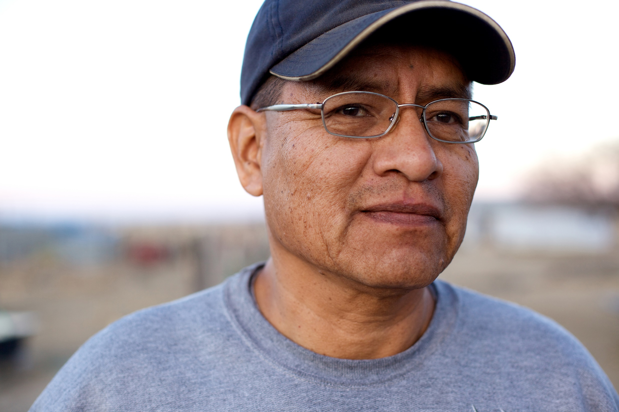
^{KNOW YOUR RIGHTS}
Michelle Sardone, Catholic Legal Immigration Network, Inc.

Slide 31
How Can You Help?
Be informed
Accurate information
Know where to send people
Educate the community
People impacted by the EOs
Faith community
Have a plan
What will you do?
Notes:
MS

Slide 32
Know Your Rights Sessions
Choose a safe space
Schedule at a convenient time
Provide information in multiple languages
Refer people to quality service providers
Warn against unscrupulous actors in the community
Invite local partners
Do not give legal advice

Slide 33
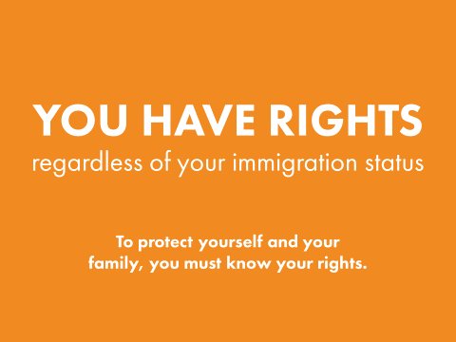
What Should You Cover?
What everyone needs to know during interactions with law enforcement
Including in different locations (at home, in the workplace, in a car, etc.)
How to read different types of warrants
Things to remember in ANY situation
How to plan
Notes:
Goal isn’t to frighten people but it is to make them aware of the reality of the situation. An attitude of “this can’t happen to me” could be disastrous for individuals, families, and communities.
Educate your community on their full scope of rights and responsibilities. Knowing your rights is the best line of defense.
Inspire and empower people to be proactive and take action now to prepare.
12 things to remember:
Anything you say can be used against you.
You have the right to remain silent.
If you wish to remain silent, say it out loud or show your KYR card.
Always carry U.S. ID and copies of immigration documents.
Never carry false documents or documents from another country.
New lie to officers
You have the right to speak with your attorney.
Never run in a raid or if you are approached by officers.
Never physically fight back if you are being arrested or detained.
You have the right to refuse to sign anything before speaking with your attorney.
If you are in police custody or detention, do not discuss your immigration info or criminal history with ANYONE other than your attorney.
If you are questioned or in a raid, write down what happened in detail as soon as it is safe to do so. Tell your attorney and support groups right away.

Slide 34
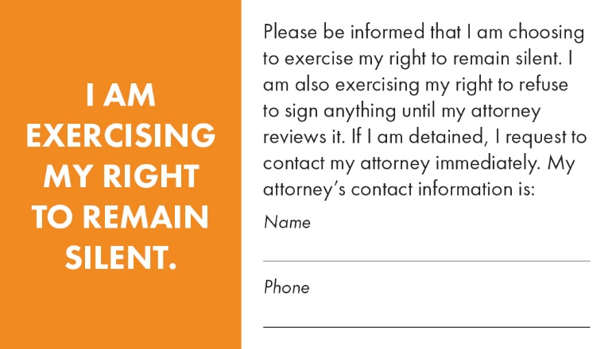
What Should the Presentation Include?
LOCAL information
Whether individuals are required by law to give their names when stopped by police on the street
Whether individuals live in a 287(g) jurisdiction
Where to find help locally
Immigration legal service providers
Family law providers
Consulates
Role plays
Call to action
Notes:
Take action now:
Find an attorney or accredited representative
Get screened for immigration options
Register with your consulate, church, other community or religious center
Make a family plan
Make copies of all immigration and other important documents
Make a childcare plan
Save money
MAKE SURE EVERYONE IN YOUR FAMILY KNOWS THEIR RIGHTS
Information you MUST MEMORIZE:
The phone number of your attorney/accredited representative
The phone number of your consulate
The phone numbers of family members
Your Alien Registration Number/ A # (the number on your immigration documents)
Your date of entry into the United States
Your immigration status when you entered the United States
Your current immigration status
Your criminal history

Slide 35
CLINIC Resources
Sample KYR presentation (English and Spanish)
https://cliniclegal.org/resources/know-your-rights-law-enforcement
Other KYR materials
https://cliniclegal.org/resources/know-your-rights
State-by-state Anti-UPIL resource
https://cliniclegal.org/upil
Trainings
https://cliniclegal.org/training/calendar
Notes:
We are working on other languages
KYR cards
KYR packets (general, school, workers)
An emergency planning checklist to be used by families and/or individuals
An emergency contact sheet to fill out
A checklist of questions to ask if a loved calls from police custody or detention, AND
A workplace checklist to provide guidance in developing an emergency plan with co-workers and working with union reps when applicable.

Slide 36
Other Helpful Resources
KYR for refugees: https://greateras1.org/learn/information-materials/
KYR Videos
CHIRLA: http://chirla.org/resources
Justice for Immigrants: http://justiceforimmigrants.org/news/resources/
Geographic specific information:
CA: https://www.ilrc.org/family-preparedness-plan
MD: http://wearecasa.org/resources/know-your-rights/
KYR in other languages: http://iamerica.org/know-your-rights
Notes:
CWS – English, Nepali, Somali, French, Arabic
CHIRLA and JFI – English, Spanish
ILRC – English, Spanish
CASA – English, Spanish, Arabic
iAmerica – English, Spanish, Polish, Korean, Tagalog, Simplified Chinese, Vietnamese, Khmer, Hindi, and Haitian Creole

Slide 37
Know Where to Refer People
CLINIC Affiliates www.cliniclegal.org/directory
DOJ Recognized Organizations https://www.justice.gov/eoir/recognition-accreditation-roster-reports
IAN National Immigration Legal Services Directory https://www.immigrationadvocates.org/nonprofit/legaldirectory/
AILA Find a Lawyer http://www.ailalawyer.com/
Notes:
MS

Slide 38
Quality Assistance is Crucial
Encourage people to seek qualified legal assistance
Find a licensed immigration attorney or DOJ accredited representative
At least 15% of undocumented individuals may be eligible for an immigration benefit!
Report immigration scams: uscis.gov/avoidscams
Notes:
MS

Slide 39
State Action Update
Meredith Owen, Church World Service

Slide 40
Major Themes in Anti-Refugee Bills
Anti-Refugee Proposals—25 anti-bills in 14 states
Requiring state legislatures to approve refugees who are resettled in the state
Requiring notification of refugee arrivals and sharing of identifying/non-identifying information about refugees
Documenting fiscal impacts of resettlement
Requiring registration of refugees with the state government
Requiring additional state background screenings of refugees
Monitoring and continual surveillance of refugees
Permitting localities to declare refugee moratorium based on the "absorptive capacity" of the community
Mandating new reporting requirements for resettlement NGOs
Limiting immigrants and refugees to temporary drivers licenses

Slide 41
Major Themes in Pro-Refugee Bills
Pro-Refugee Proposals—25 positive-bills in 15 states
Resolutions declaring a state welcoming or a school district welcoming to immigrants and refugees
Opposing President Trump’s executive orders against immigrants, refugees, and Muslims
Offering in-state tuition for SIVs
Prioritizing enrollment of students who are SIVs
Facilitating licensing based on SIV work experience overseas

Slide 42
Key States: Refugee and Immigration Proposals
Anti-Refugee Proposals
Virginia
Maine
Pro-Refugee Proposals
California
Kentucky
Anti-Immigrant Proposals
Mississippi
Texas
Michigan

Slide 43
State and Local Advocacy
Call your State and Local Officials!
Tell Them to Declare Welcome for Refugees & All Newcomers
Here’s a sample of what to say: “I am a constituent from [CITY, STATE], and I urge you to declare welcome for refugees in our communities by supporting a welcome resolution and opposing any attempts to disrupt, curtail, or dismantle the refugee resettlement program. Resettlement is a core American legacy that extends hospitality and offers a chance for refugees to rebuild their lives in safety and dignity. My community welcomes refugees, and I urge you to reflect the best of our nation by supporting refugee resettlement in the United States.”
To find your governor, state legislators, mayor, and local officials, click here: https://www.usa.gov/elected-officials. To tweet your state and local officials, click to find the twitter handles for your governor and state legislators.
Template Welcome Resolution for Refugees and Immigrants: http://www.rcusa.org/blog/2017-post-election-rcusa-toolkit-visits-with-local-state-and-national-leaders-to-welcome-refugees
Ask community members to sign these sector-specific letters:
bit.ly/Business4Refugees
bit.ly/Educators4Refugees
bit.ly/LawEnforcement4Refugees
bit.ly/Health4Refugees
bit.ly/FaithLeaders4Refugees

Slide 44
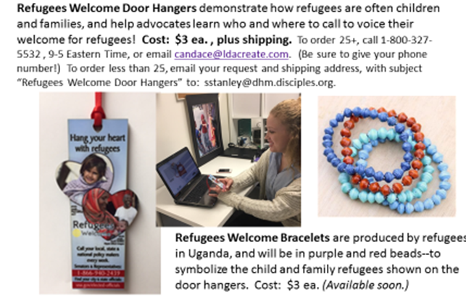
Refugees Welcome Door Hangers demonstrate how refugees are often child and families, and help advocates learn who and where to call to voice their welcome for refugees!
Visit the Refugees Welcome website to purchase and learn more:
http://www.refugeesarewelcome.org/hangyourheartwithrefugees/
Email Meredith from CWS at mowen@cwsglobal.org for more information.

Slide 45
Lifting Up Stories
We are seeking stories of those affected by the ban, including but not limited to:
Refugees who were expecting or hoping to come to the U.S.
U.S. residents or citizens who were expecting their family members to join them in the U.S.
Congregations and communities who were expecting to welcome refugees (i.e. furnishing apartments, collecting donations, etc.)
Businesses, schools, and other institutions that are affected by lower refugee admissions.
Share these stories here.

Slide 46
IIC Contacts by organization
African American Ministers in Action: Leslie Malachi, lmalachi@pfaw.org
American Baptist Home Mission Societies of the American Baptist Churches, USA: Brenda Halliburton, brenda.halliburton@abhms.org
American Friends Service Committee: Kathryn Johnson, kjohnson@afsc.org
American Jewish Committee: Richard Foltin, foltinr@ajc.org
Bread for the World Institute: Marco Grimaldo, mgrimaldo@bread.org
Christian Church (Disciples of Christ): Sharon Stanley, sstanley@dhm.disciples.org
Christian Reformed Church: Kelsey Herbert, kherbert@crcna.org
Church of the Brethren: Nate Hosler, nhosler@brethren.org
Church World Service: Jen Smyers, jsmyers@cwsglobal.org
CLINIC: Michelle Sardone, msardone@cliniclegal.org
Columban Center for Advocacy and Outreach: Rebecca Eastwood, reastwood@columban.org
Conference of Major Superiors of Men: Eli McCarthy, emccarthy@cmsm.org
Daughters of Charity: Mary Ellen Lacy, Maryellen.lacy@doc.org
Episcopal Church: Lacy Broemel, lbroemel@episcopalchurch.org
Evangelical Lutheran Church in America: Alaide Vilchis Ibarra, Alaide.Ibarra@elca.org
Franciscan Action Network: Marie Lucey, lucey@franciscanaction.org
Friends Committee on National Legislation: Hannah Evans, hannah@fcnl.org
HIAS: Liza Lieberman, liza.lieberman@hias.org
Ignatian Solidarity Network: Christopher Kerr, ckerr@ignatiansolidarity.net
Interfaith Worker Justice: Laura Barrett lbarrett@iwj.org
Irish Apostolate USA: Marie Prefontaine, coordinator@usairish.org
Jesuit Conference of Canada and the U.S.: Kristen Lionetti, klionetti@jesuits.org
Jesuit Refugee Service/USA: Guilia McPherson, gmchperson@jesuits.org
Jewish Council for Public Affairs: Krissy Roth, kroth@thejcpa.org
Leadership Conference of Women Religious: Ann Scholz, SSND ascholz@lcwr.org
Lutheran Immigration and Refugee Service: McKayla Eskilson, meskilson@lirs.org
Maryknoll Office for Global Concerns: Judy Coode, jcoode@maryknoll.org
Mennonite Central Committee U.S.: Tammy Alexander, TammyAlexander@mcc.org
Muslim Public Affairs Council: Hoda Elshishtawy, hoda@mpac.org
Sisters of the Good Shepherd: Larry Couch, lclobbyist@gsadvocacy.org
National Council of Churches: Russell Meyer, rmeyer@floridachurches.org
National Council of Jewish Women: Faith Fried, Faith@ncjwdc.org
National Justice for Our Neighbors: Rob Rutland-Brown, rob@njfon.org
NETWORK Lobby: Laura Peralta-Schulte, LPeralta@networklobby.org
Pax Christi: Anne-Louise Nadeau, anadeau@paxchristiusa.org
PICO: Rich Morales rmorales@piconetwork.org
Presbyterian Church, USA: Teresa Waggener, Teresa.Waggener@pcusa.org
Scalibrinian International Migration Network/Center for Migration Studies: Kevin Appleby; kappleby@cmsny.org
Sisters of Mercy of the Americas: Jean Stokan, jstokan@sistersofmercy.org
Sojourners: Michael Mershon mmershon@sojo.net
T’ruah: The Rabbinic Call for Human Rights: Rabbi Rachel Kahn-Troster, rkahntroster@truah.org
Union for Reform Judaism: Shelby Friedman, sefriedman@rac.org
Unitarian Universalist Association: Susan Leslie, SLeslie@uua.org
Unitarian Universalist Service Committee: Hannah Hafter, hhafter@uusc.org
United Church of Christ: Jason Carson Wilson, wilsonj@ucc.org
United Methodist Church: Jeania Ree Moore, jmoore@umc-gbcs.org
UNITED SIKHS: Anisha Singh, anisha.singh@unitedsikhs.org
U.S. Conference of Catholic Bishops: Todd Scribner, tscribner@usccb.org
World Relief: Jenny Hwang, jhwang@worldrelief.org

